Slide 1
Interruption of transmission and elimination of leprosy disease
Dr Rashmi Shukla
NPO Leprosy
WHO

Slide 2
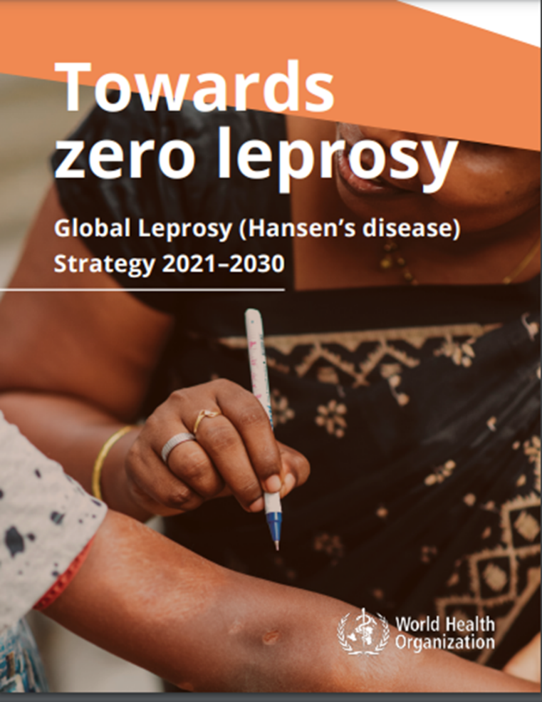

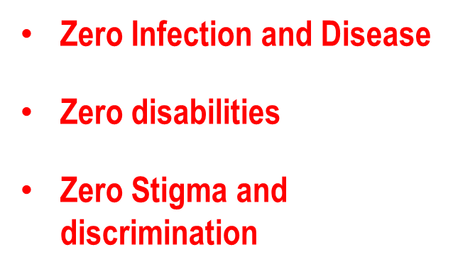
Leprosy: Global Target 2030
Vision-Acceleration of Action
to achieve
7
Goal : Zero Leprosy i.e. Interruption of transmission

Slide 3
Global targets for 2030
Interruption of Transmission and Elimination of leprosy
Reduction
in rate (per million) of new cases with Grade-2 disability
Zero
new indigenous (autochthonous) cases
NEW G2D Rate
ZERO NEW CASES
Reduction
in Annual New cases detection (with active case detection)
Reduction
in rate (per million children) of New Child cases with leprosy
NEW ANCDR
NEW Child G2D Rate

Slide 4




Global Goal
Zero Leprosy i.e. Interruption of transmission
Interruption of Transmission Zero child case for 5 years
Elimination of leprosy
Zero adult case for 3 years
Post Elimination Surveillance
4

Slide 5



1. Leprosy Elimination Framework
The Leprosy Elimination Framework provides a systematic and standardized way of tracking country progress in their fight against leprosy.
Shows phases of elimination and the associated indicators and milestones.
Elimination of leprosy
 | Phase 1 | Phase 2 | Phase 3 | Non-endemic status
Description | Until interruption of transmission | Interruption of transmission until elimination of disease | Post-elimination surveillance | Leprosy is not normally present in the area or country. Sporadic cases may occur.
Milestone to move to next phase | No new autochthonous cases among children for at least 5 consecutive years | No new autochthonous cases for at least 3 consecutive years (and no child cases in 5 years) | No or only sporadic autochthonous cases for a period of ≥ 10 years
Endemicity
High Endemic
Low Endemic
Non Endemic
Verification of elimination of leprosy disease
(sub-national level upwards)

Slide 6
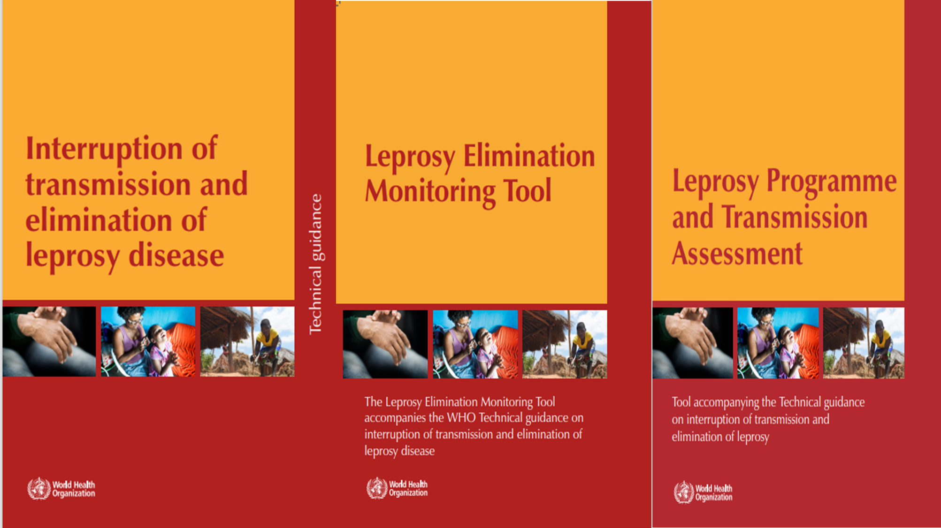

Slide 7
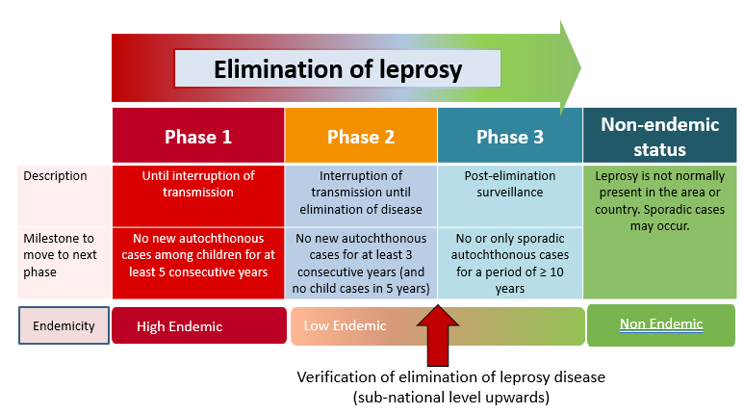
2. The Leprosy Elimination Monitoring Tool (LEMT) on DHIS 2 available
Developed based on the Leprosy Elimination Framework.
Promotes a standard way to monitor progress towards interruption of transmission and elimination of leprosy disease in detail
Leprosy Elimination Framework.

Slide 8
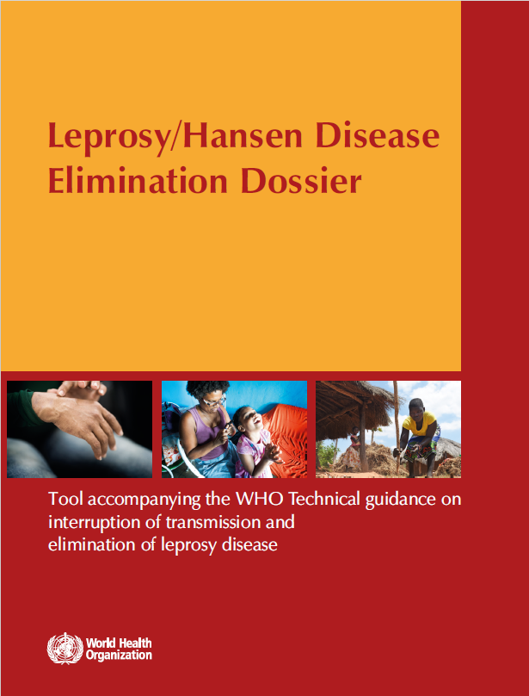
Purpose of the Dossier
Systematically document initiatives undertaken to eliminate leprosy
Provide a comprehensive record of interventions
Highlights outcomes
Supports the official verification process
Serves as a repository of evidence, data and insights substantiating the elimination claims.

Slide 9
Contents of the Dossier
Introduction
Health situation and general indicators of health and development
Health-care delivery system
Progress in eliminating leprosy disease
Political commitment
Programme Implementation
Surveillance
Additional information
Information to be provided in annexures

Slide 10
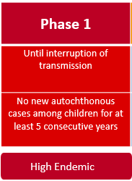
Phase 1 of Leprosy Elimination Framework
The milestone for interruption of transmission has been defined as ‘zero new autochthonous cases among children (<15 years of age) for at least 5 consecutive years’.
Past epidemiological research has shown that when the incidence of leprosy declines, age at detection shifts towards older ages (Hambridge et al., 2021).
Manifestation of disease in children under 15 years of age thus indicates relatively recent transmission.
Rate, proportion or number of autochthonous cases among children (<15 years of age) are used as proxy indicators for recent transmission.
sporadic child cases can still occur during Phase 2.

Slide 11
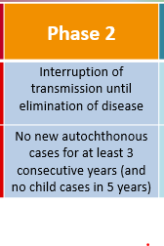
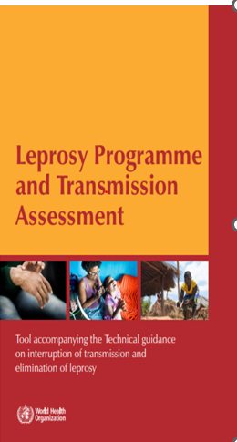
Phase 2 of Leprosy Elimination Framework
Elimination of leprosy disease is achieved when an administrative area has not diagnosed any new autochthonous cases for at least three consecutive years.
The achievement should be verified by carrying out a Leprosy Programme and Transmission Assessment (LPTA).

Slide 12
Verification of Phase 2 of Leprosy Elimination Framework
After confirmation, unit transitions into Phase 3, the Post-elimination surveillance phase.
Due to the long incubation period, sporadic cases are still likely to occur from time to time. Leprosy could re-emerge in the unit.
Re-emergence should be considered when the following criterion is met ‘the occurrence of 3 or more cases of leprosy on average in 3 consecutive years in one area’.

Slide 13
Verification of Phase 2
Every remerging cases should be carefully investigated.
If no operational reason for the increased incidence is found, and if new cases continue to occur at the same or an increased level, the health authorities may decide to reverse the area to the previous phase of elimination.
Each sporadic child case should also be investigated closely to assess whether infection is likely to have been acquired locally, to see if an index case can be established and whether there are any secondary cases among contacts.

Slide 14
Verification of Phase 2 of Leprosy Elimination Framework
Leprosy Programme and Transmission Assessment (LPTA) is an activity that is carried out by internal teams towards the end of Phase 1 when a subnational unit (State) reaches the milestone for interruption of transmission.
Verify all relevant programme criteria have been met and examine trends of epidemiological indicators to confirm that the milestone has been achieved.
LPTA includes assessment of health facilities that provide leprosy services.

Slide 15
Verification of Phase 2 of Leprosy Elimination Framework
Review of epidemiological data
Health facility assessment
Data validation
Verification of the programme criteria through observation during a field visit.
The evidence collected in this way in subnational health administrative units is compiled in a Leprosy Elimination Dossier to be submitted for verification when the country reaches the milestone for elimination of disease in the country as whole.

Slide 16
National strategic plan/national health plan to achieve interruption of transmission and elimination of leprosy disease available with resource allocation for the strategic plan.
A health plan providing for an integrated leprosy case detection and treatment services is available
SOPs for diagnosis, management, prevention, rehabilitation including care of disabilities are available
National health plan to sustain expertise in leprosy and programme management
A well-defined referral system from community to a sentinel centre/centre of excellence/referral unit is in place
Drug procurement and supply chain management are in place
Advocacy materials (e.g. information booklets, infographics and videos) are available for sensitizing policy makers at subnational level are available
Verification

Slide 17
Existing laws/policies/traditional practices/regulations that allow discrimination against persons affected by leprosy
Number of instances of discrimination reported
Social support e.g. entitlements, pension/welfare schemes for persons with disability include persons affected by leprosy
Organisations of persons affected by leprosy or disability, NGOs*, private practitioners, academia participate in programme planning and management
Associations of persons affected by leprosy exist and participation is ensured.
Leprosy care package and prevention activities are implemented in integrated manner.
Referral unit with facilities to suspect, diagnose and treat leprosy are available
Verification

Slide 18
Training status of health workers at designated level (health centres and referral units)
Awareness campaigns- media
Level of awareness in the general community and among traditional healers and opinion leaders
Diagnosis, treatment of patients, management of reactions and prevention and care of disabilities are in line with SOPs
Drugs required to manage leprosy and reactions are available
Referral mechanism with designated levels from community to apex/sentinel/referral unit in place
People with leprosy-related disabilites who received assistive technology devices or other rehabilitation services
Verification

Slide 19
Proportion of cases for whom contact tracing was undertaken (for patients registered in the past five years) (Target: >80%)
Proportion of contacts examined (Target: >80%)
Adoption of SDR-PEP
Proportion of eligible contacts who received SDR (Target: >95%)
A digital data management system is in place
Reporting is done at subnational level (including zero case reports)
Verification

Slide 20
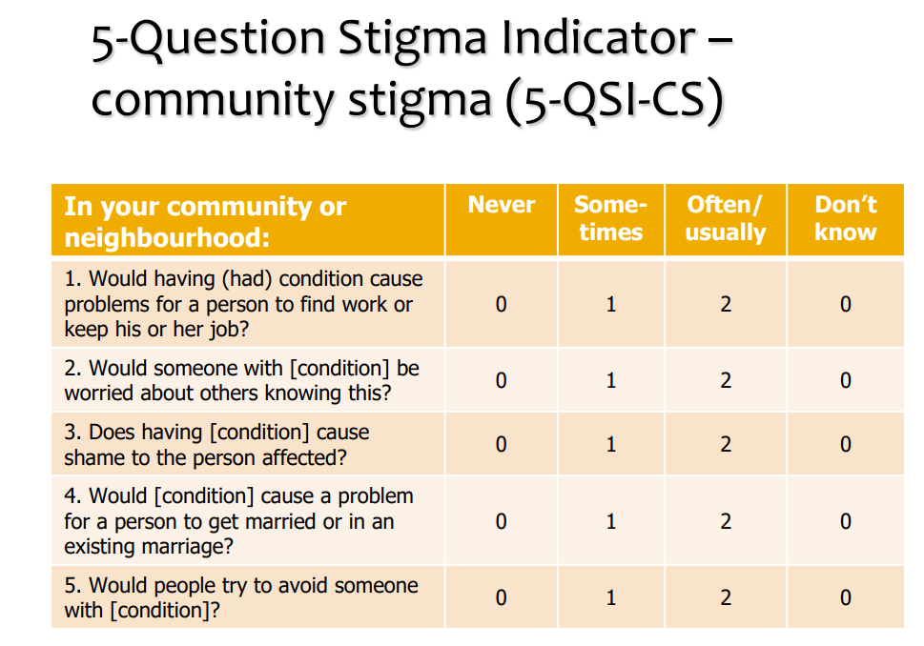
Leprosy-related stigma in communities and among health workers is monitored (using tools such as 5-QSI-CS/AP) 5-Question Stigma Indicator - Community Stigma

Slide 21
New autochthonous leprosy patients have been geographically mapped (Target: >90%)
Number of contacts listed per index patient (as per the national plan)
Persons not found to have leprosy among persons screened with signs suggestive of leprosy
Leprosy is included as one of the diseases in migrant or displaced persons health screening and care programmes
Sentinel centre/apex centre/centre of excellence/referral unit with staff trained to diagnose and manage leprosy is available at an appropriate level (district/municipality or state/province)
Verification

Slide 22
Critical instance investigation of sporadic cases (child cases in Phase 2) is in place
Progress in leprosy elimination is monitored at the subnational level using the LEMT*
Programme services are monitored using the LPTA*
Private practitioners are involved in treating of complications of leprosy and disabilities of eyes, hands and feet
Availability of over-the-counter leprosy drugs used in treatment of leprosy
System in place to test for possible drug resistance
Number of relapse cases tested
Pharmacovigilance system in place
Verification

Slide 23
Verification
Review of epidemiological data
Epidemiological analysis through review of data at second subnational level is to be done over a period of 10–20 years. The data should be presented as trends for the indicators listed in Chapter 6 in the Technical guidance on interruption of transmission and elimination of leprosy.
Interruption of transmission
New case rate among children
Number of new autochthonous child cases (<15 years of age) detected
(Trend in) MB percentage among new cases
Elimination of leprosy disease
Number of new autochthonous cases detected
New case detection rate (autochthonous cases only)
Proportion of foreign-born among total new cases detected
Rate of new cases with Grade- 2 disability
Prevalence rate

Slide 24
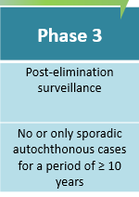
Phase 3 of Leprosy Elimination Framework
After achieving the elimination of leprosy disease milestone, an area or country transitions into the Post-elimination surveillance phase.
Due to the long incubation period of M. leprae, sporadic new cases of leprosy may still occur. It is very important that sporadic new cases are investigated thoroughly to assess whether infection is likely to have been acquired locally, to see if an index case can be established.

Slide 25
Phase 3 of Leprosy Elimination Framework
Contact screening should also be done in this phase to investigate whether there are any secondary cases among contacts.
Evidence suggests that, at this stage of endemicity, the risk of secondary cases occurring is very low.
Robust surveillance is still essential during this phase to detect, diagnose, treat and report any ‘sporadic cases’ that may occur. Sporadic cases should be unrelated to other concurrent local cases and not be connected by contact in recent years.

Slide 26
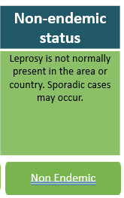
Non-endemic status
An area or country has achieved ‘Non-endemic status’ if no or only sporadic new autochthonous cases have been detected for a minimum of 10 years.
A robust surveillance and response system should be in place to detect, diagnose, treat and report any ‘sporadic cases’ that may occur.
Regular surveillance should be continued for early detection of sporadic cases among non-autochthonous population.

Slide 27
Arunachal Pradesh- Adult Cases
Interruption of transmission of leprosy achieved
Elimination of leprosy achieved

Slide 28
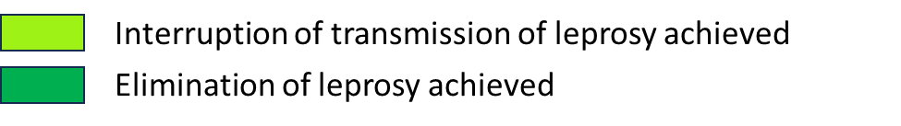
Manipur

Slide 29


