Slide 1
Insights from a Community Initiative on Mental Health.

Slide 2
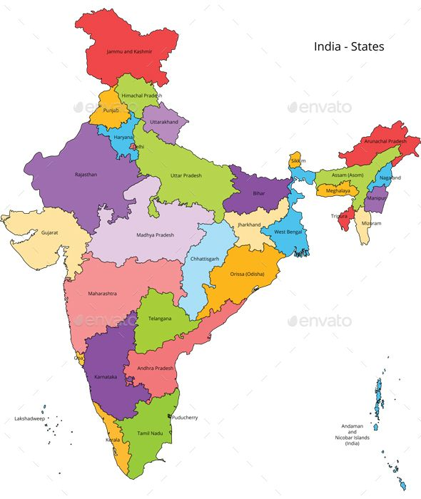
Project Location and Rationale
Leprosy burden
Significant number of persons affected by leprosy with visible disability and ongoing stigma
Mental health concerns were identified during routine programme interactions.
Muzaffarpur
Why these sites were selected
Presence of established leprosy services and community-based programs
Sites offered a realistic context to explore feasibility before wider replication

Slide 3
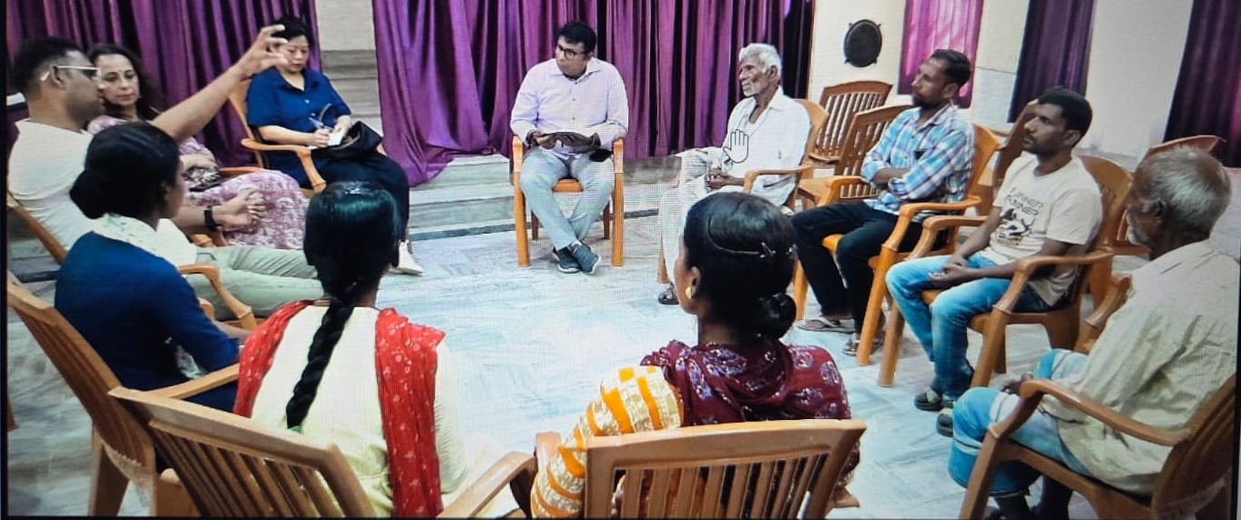
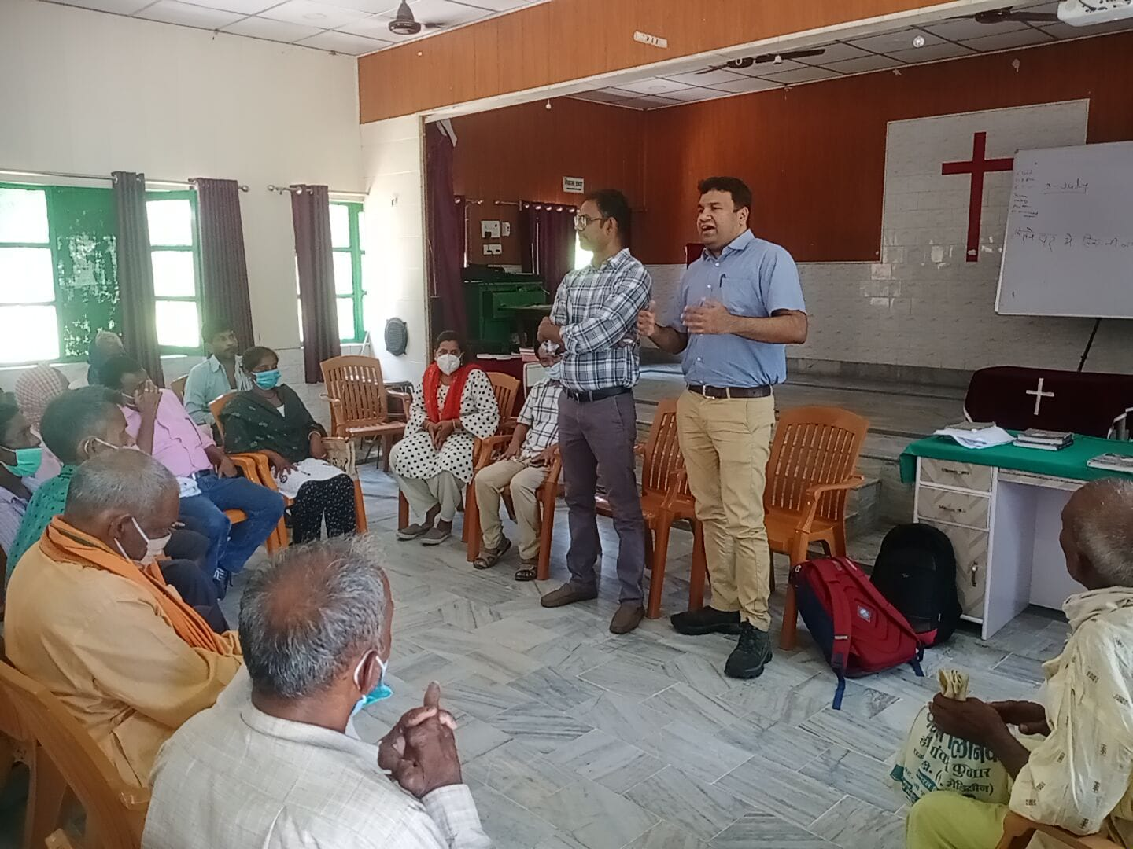
Needs Assessment: Why Mental Health Could Not Be Ignored
High prevalence of anxiety and depression among persons affected by leprosy
Mental health concerns strongly linked with disability, ulcers, and livelihood loss
Community beliefs: mental health problems seen as “incurable”
Limited access to mental health services in routine leprosy care

Slide 4
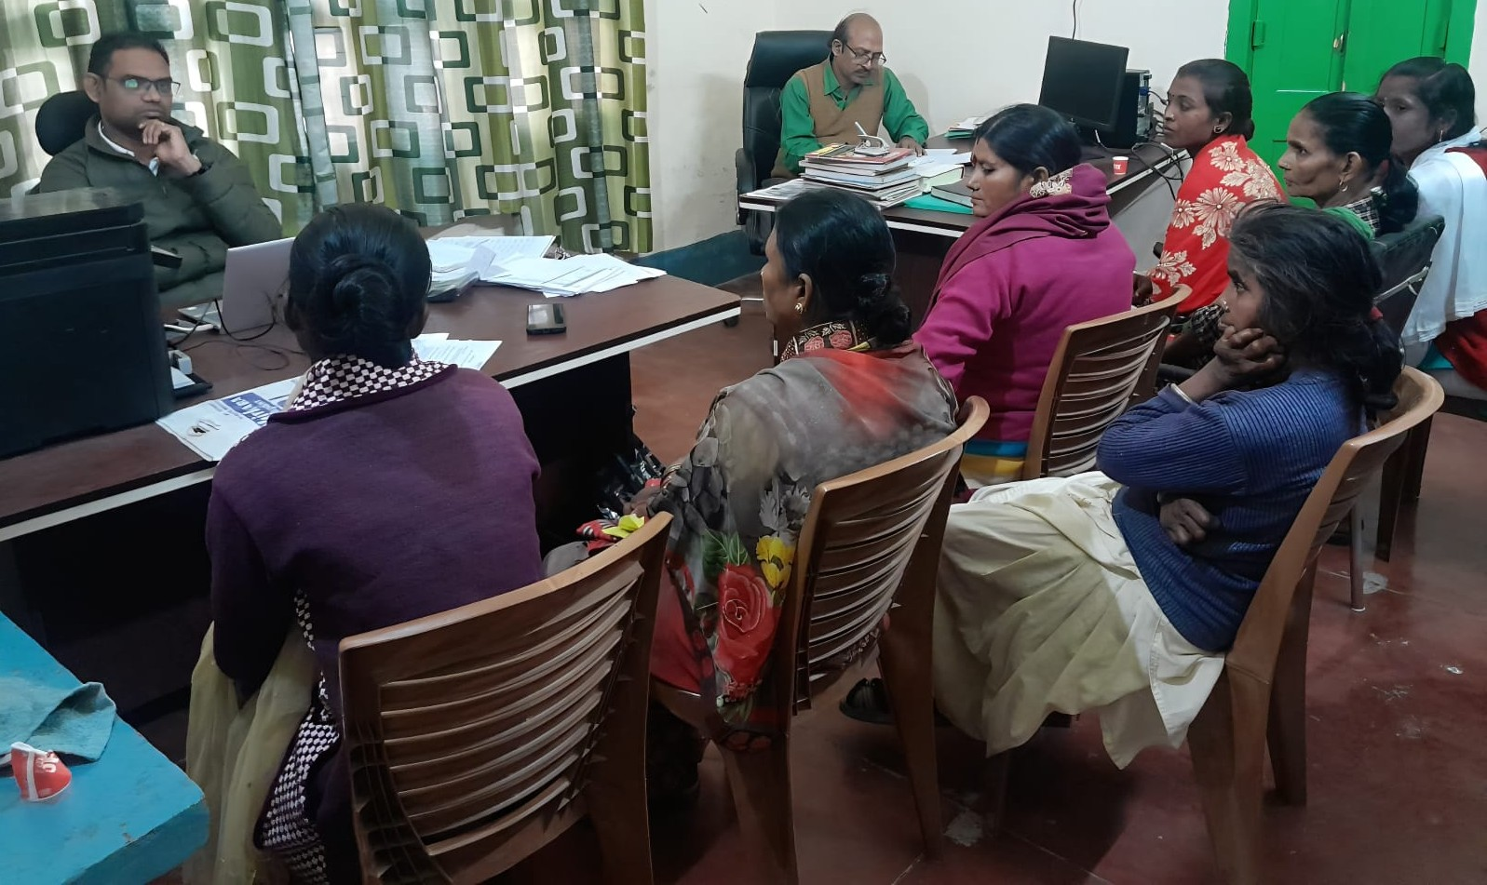
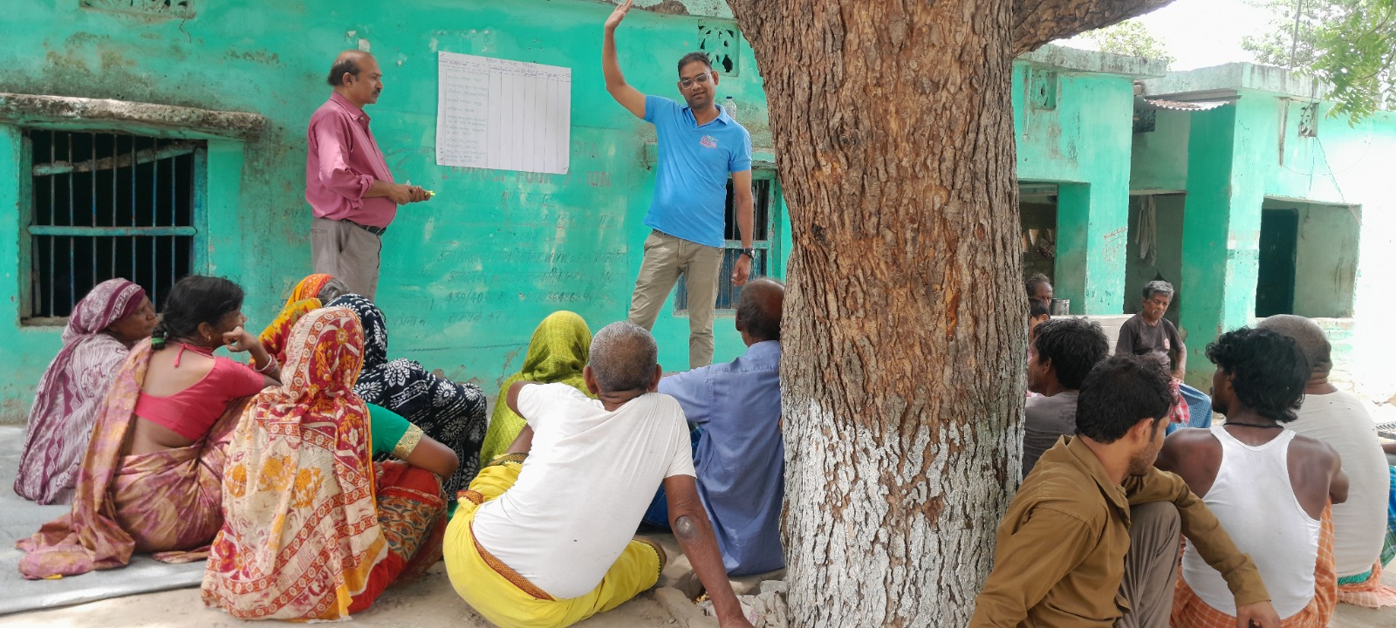
Participation at the Core of the Project
Persons affected as co-thinkers and co-designers
Lived Experience Auditors and Facilitators (LEAF) supporting data collection Community Knowledge Exchange Space (CKES) production
Local Advisory Group (LAG) for guiding design
Families & community leaders

Slide 5
Phases of Implementation
Phase 1: Understanding Lived Experiences and Emotional Distress
Qualitative and quantitative assessment to describe lived experiences and negative emotional states among persons affected by leprosy
Phase 2: Pilot Co-production Phase
Testing the feasibility of participatory co-production processes through Community Knowledge Exchange Spaces (CKES)
Phase 3: Full Co-production Phase (Ongoing)
Strengthening and scaling co-produced, locally rooted mental health interventions with community and system partners

Slide 6
Learning: Phase 1
High levels of anxiety, depression, and stress were commonly reported among persons affected by leprosy
Emotional distress was closely linked with disability, chronic ulcers, Gender, habitants, and livelihood insecurity
Mental health concerns were often normalized, hidden, or perceived as “incurable”
Distress was shaped by social isolation, stigma, and uncertainty about the future

Slide 7
Learning from the Pilot Co-production Phase
Co-production was feasible and acceptable to persons affected by leprosy
Trust and safe spaces were essential before discussing mental health openly
Peer support and shared reflection reduced isolation and self-blame
Locally meaningful approaches mattered more than clinical labels
Involving government programme staff enriched dialogue and improved system alignment

Slide 8

Some of the Findings
Notes:
After consulting a variety of sources, you will need to narrow your topic. For example, the topic of internet safety is huge, but you could narrow that topic to include internet safety in regards to social media apps that teenagers are using heavily. A topic like that is more specific and will be relevant to your peers. Some questions to think about to help you narrow your topic:
What topics of the research interest me the most?
What topics of the research will interest my audience the most?
What topics will the audience find more engaging? Shocking? Inspiring?

Slide 9
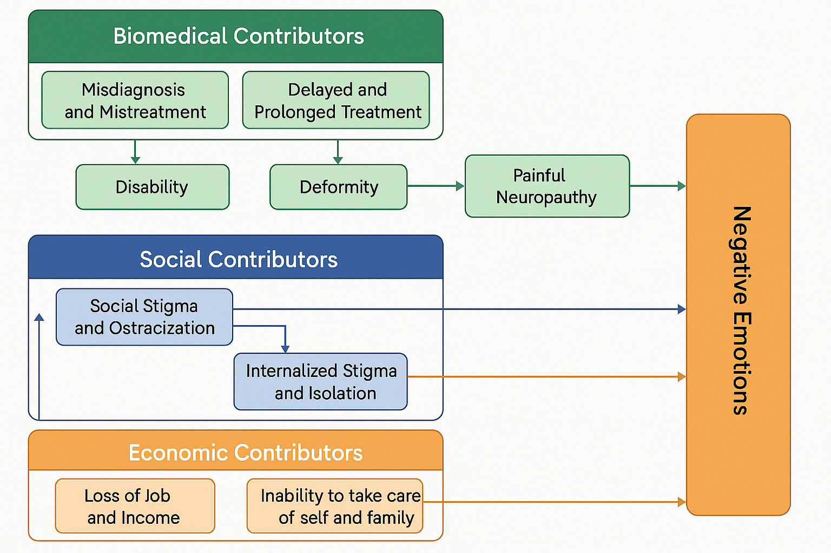
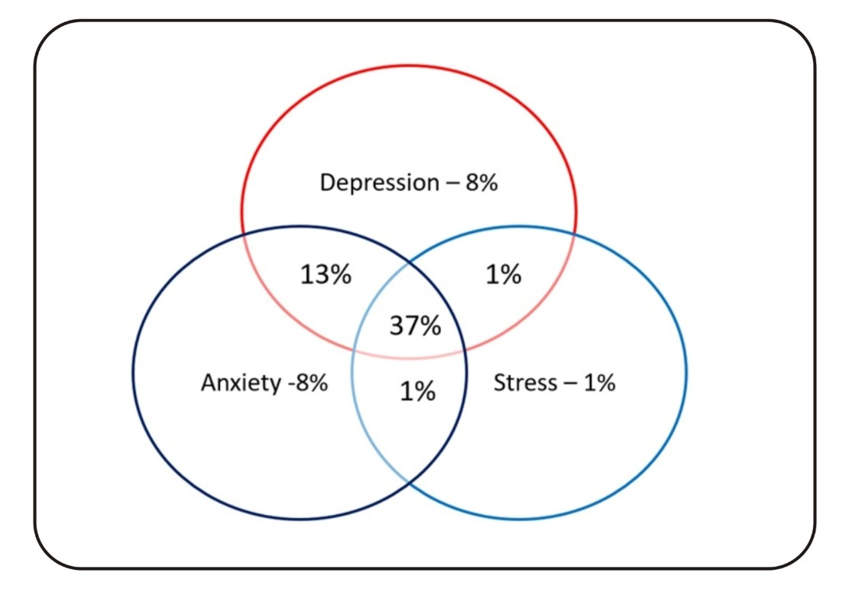
Prevalence of specific MH problems:-
Emotional distress was strongly linked to uncertain recovery, physical deformities, and social exclusion
Anxiety was commonly related to fears of worsening disability and loss of livelihood
Depressive symptoms were frequently associated with social isolation and reduced mobility

Slide 10
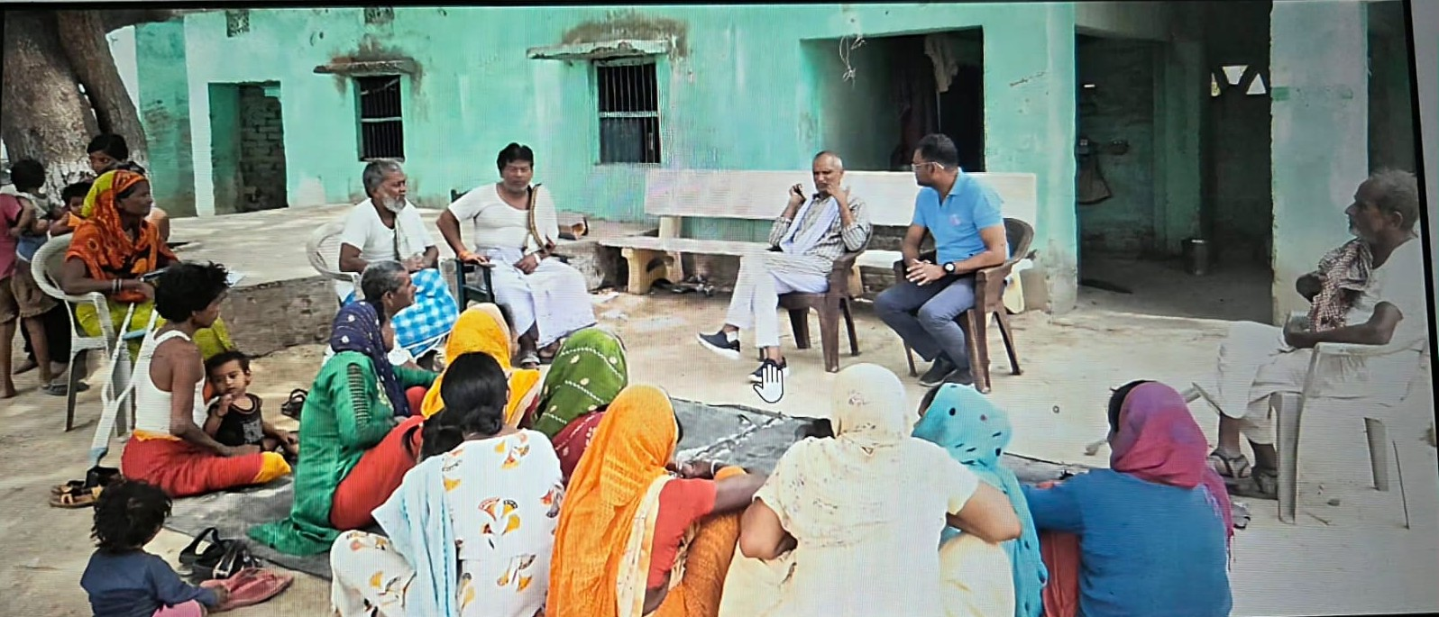

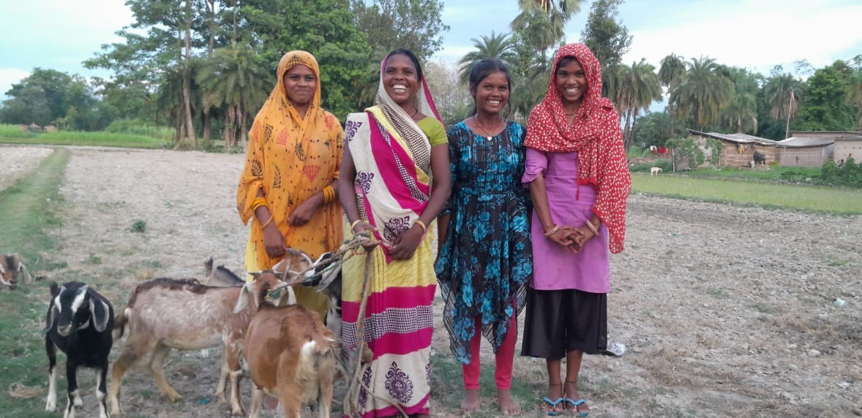
Co-produced Support Strategies and Prioritization
Psychosocial and peer support (Peer group support , Lay counselling and trusted listeners)
Family and social inclusion (Family support & Increased social interaction)
Livelihood and social protection (Socio-economic rehabilitation, access to social security)
Health and stigma-related support (doorstep medical support, awareness for stigma reduction)
Personal and cultural coping practices (meditation, prayer, and other culturally meaningful practices)

Slide 11

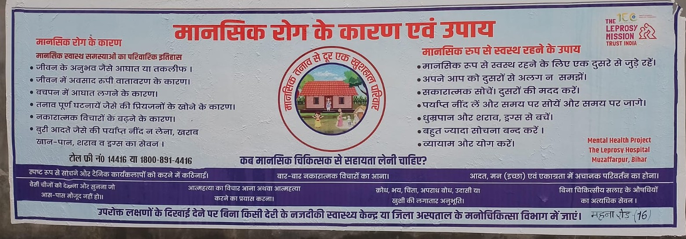
Challenges
Trust and Relationship Building
Limited Awareness and Language Gaps
Logistical Constraints
Socio-cultural Norms and Gender
System-Level Challenges

Slide 12
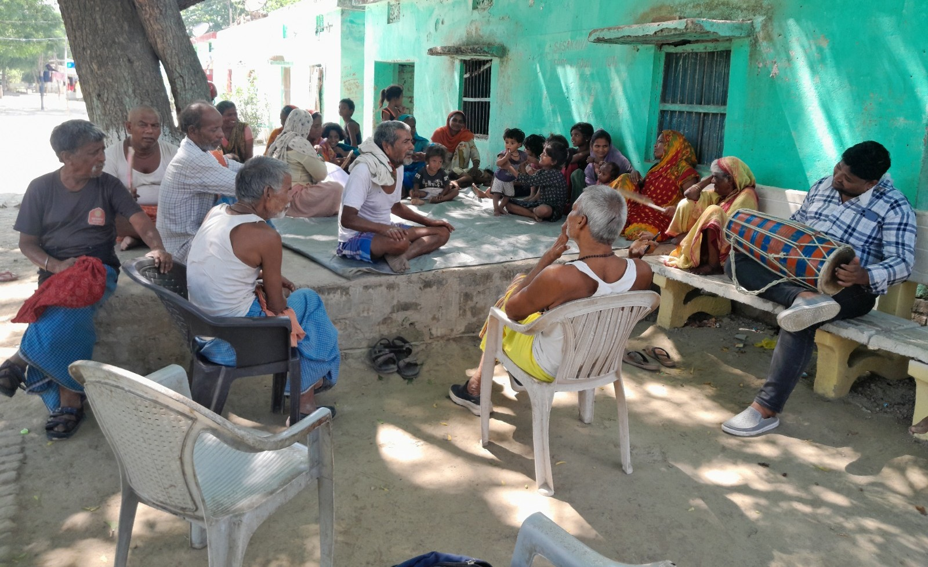
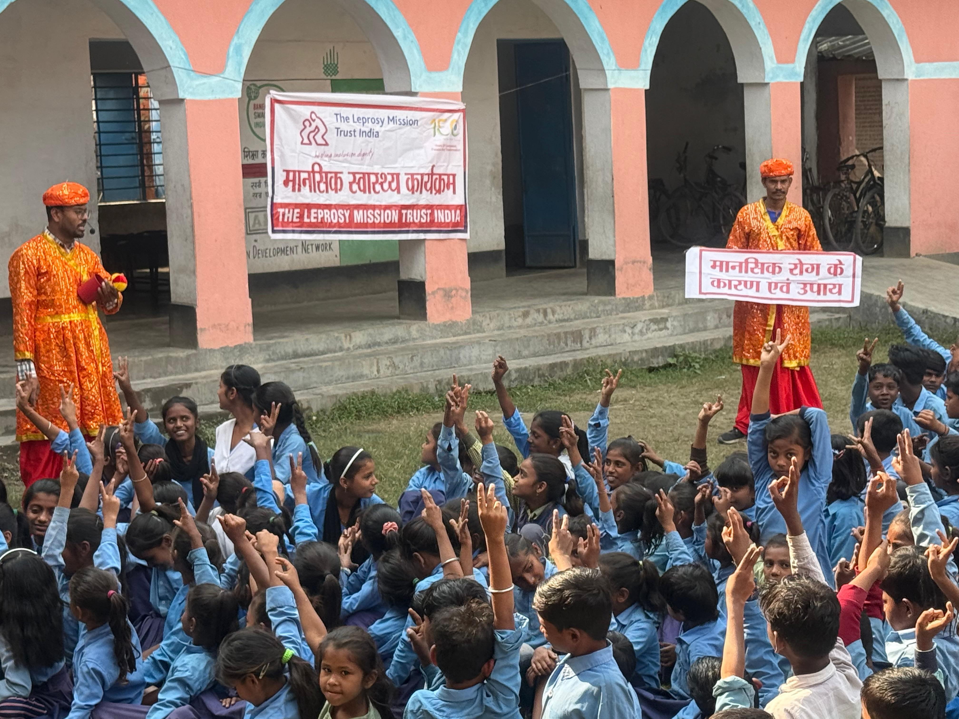
-Share learning and emerging practices through knowledge exchange and publications.
-Embed mental health support within routine leprosy care, alongside medical treatment and rehabilitation
-Refine and document a replicable, locally rooted co-production model for mental health support
-Build on this feasibility phase by expanding involvement of family members and designing a future study with a comparison group
Way Forward

Slide 13
Thank you

