Slide 1


Knowledge Sharing Series
Learnings- Capacity building of health workers to achieve Zero Leprosy Transmission by 2027
Suresh Dhondge, ILEP NLEP Consultant, Maharashtra
www.leprosymission.in
KSS 2025

Slide 2
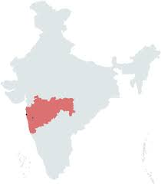

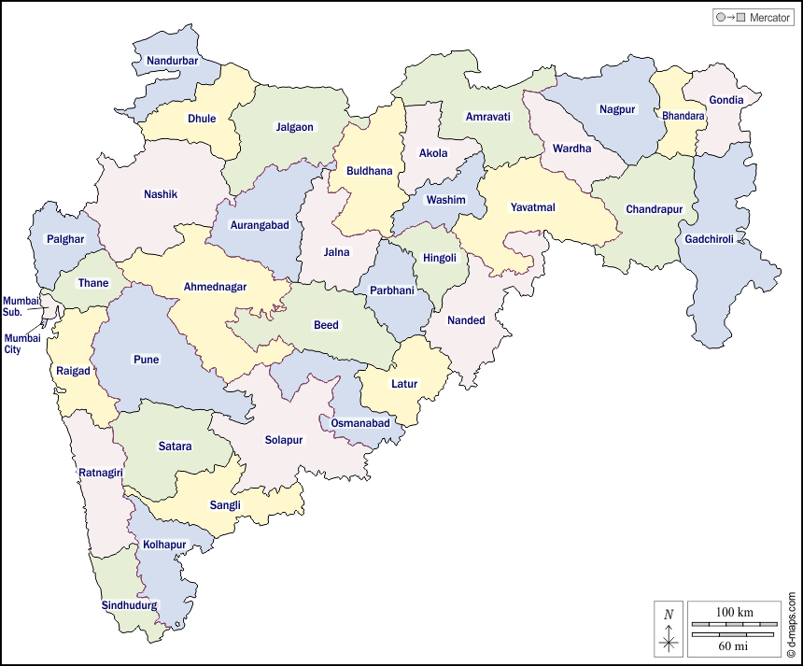
Visits..
India
Maharashtra
www.leprosymission.in
KSS 2025

Slide 3
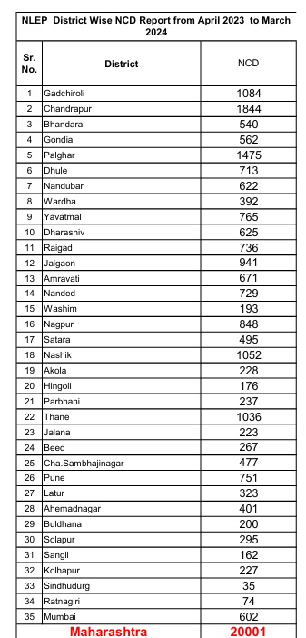
New Case Detections
New Case detections- 2023-2024 : 20001
New case detections- 2024-2025 : 17000+
www.leprosymission.in
KSS 2025

Slide 4
Capacity Buildings
ASHA | ADHS Staff | Others | Total
852 | 446 | 230 (Champions) | 1528
www.leprosymission.in
KSS 2025

Slide 5
Process..
Took Prior Appointments from district
Best Practices from each districts
Special Campaigns
Focused on Stigma Reduction and Public Awareness
New Projects
www.leprosymission.in
KSS 2025

Slide 6
Learnings & Recommendations
Data Analysis
Coordination among district departments
Involvements of key players- Synergy
We all should be on same page- Maharashtra State
Twin Track Approach
We have only 3 years….
www.leprosymission.in
KSS 2025

Slide 7
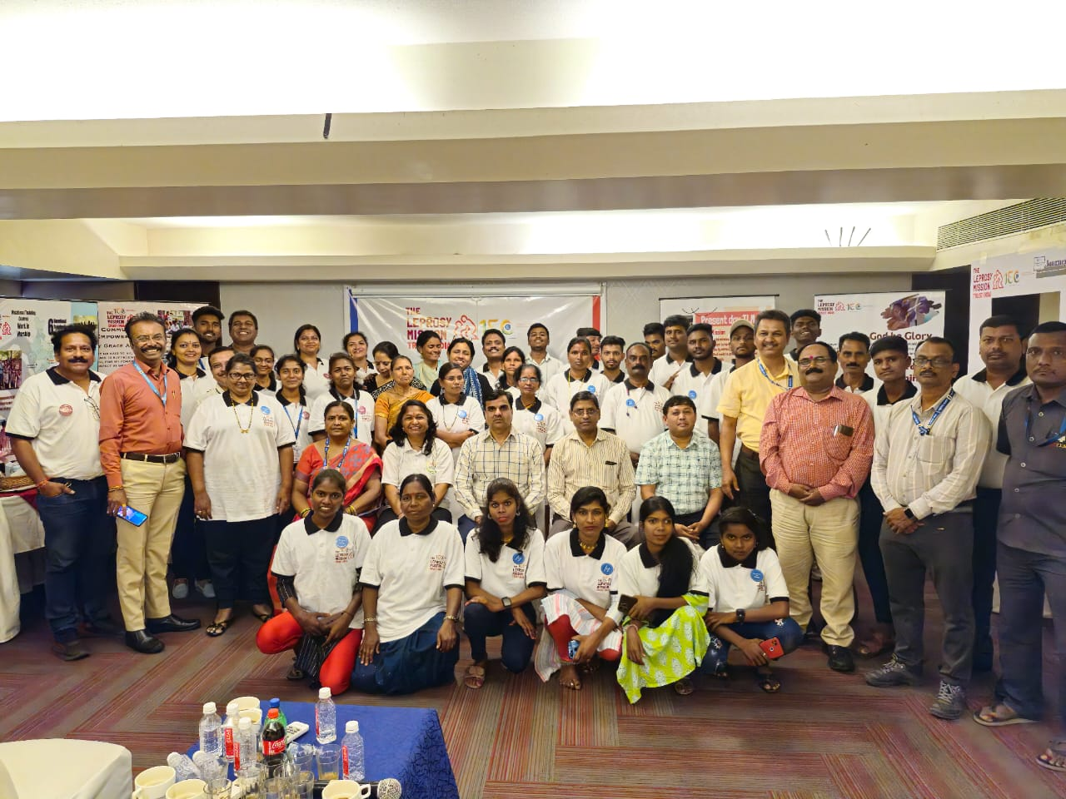
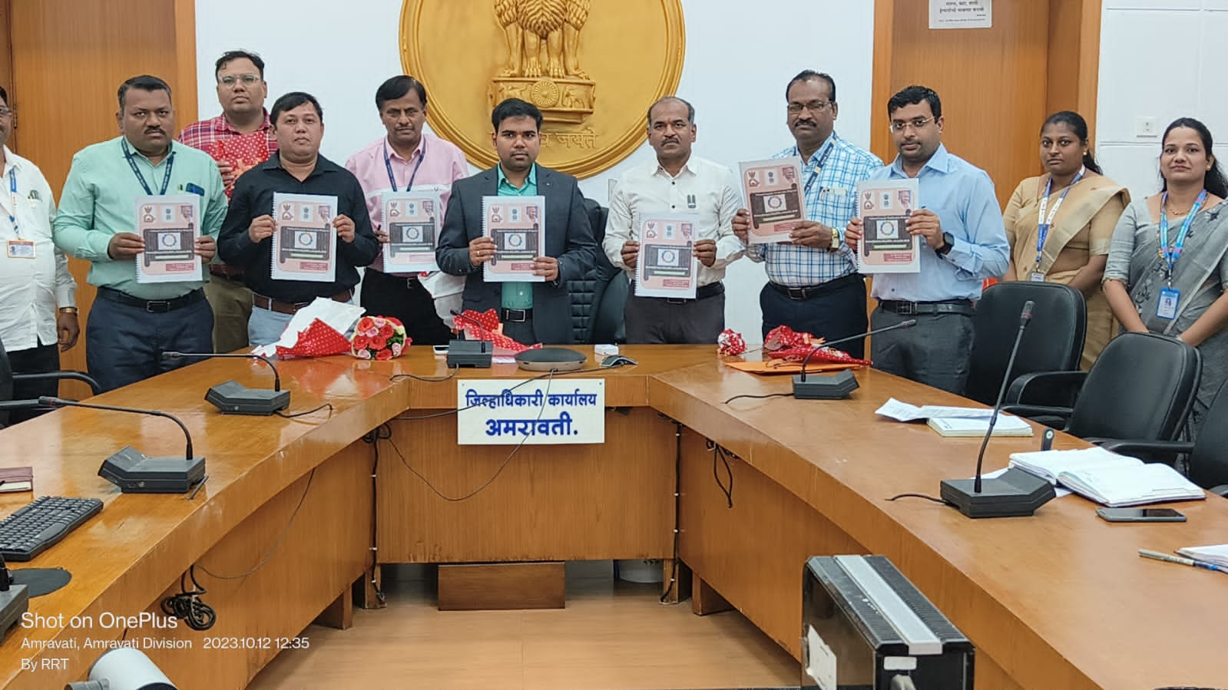
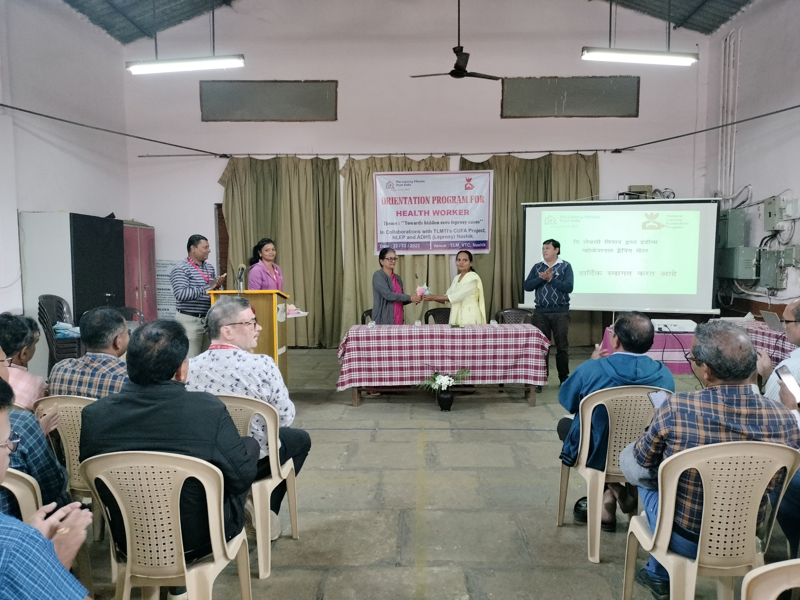
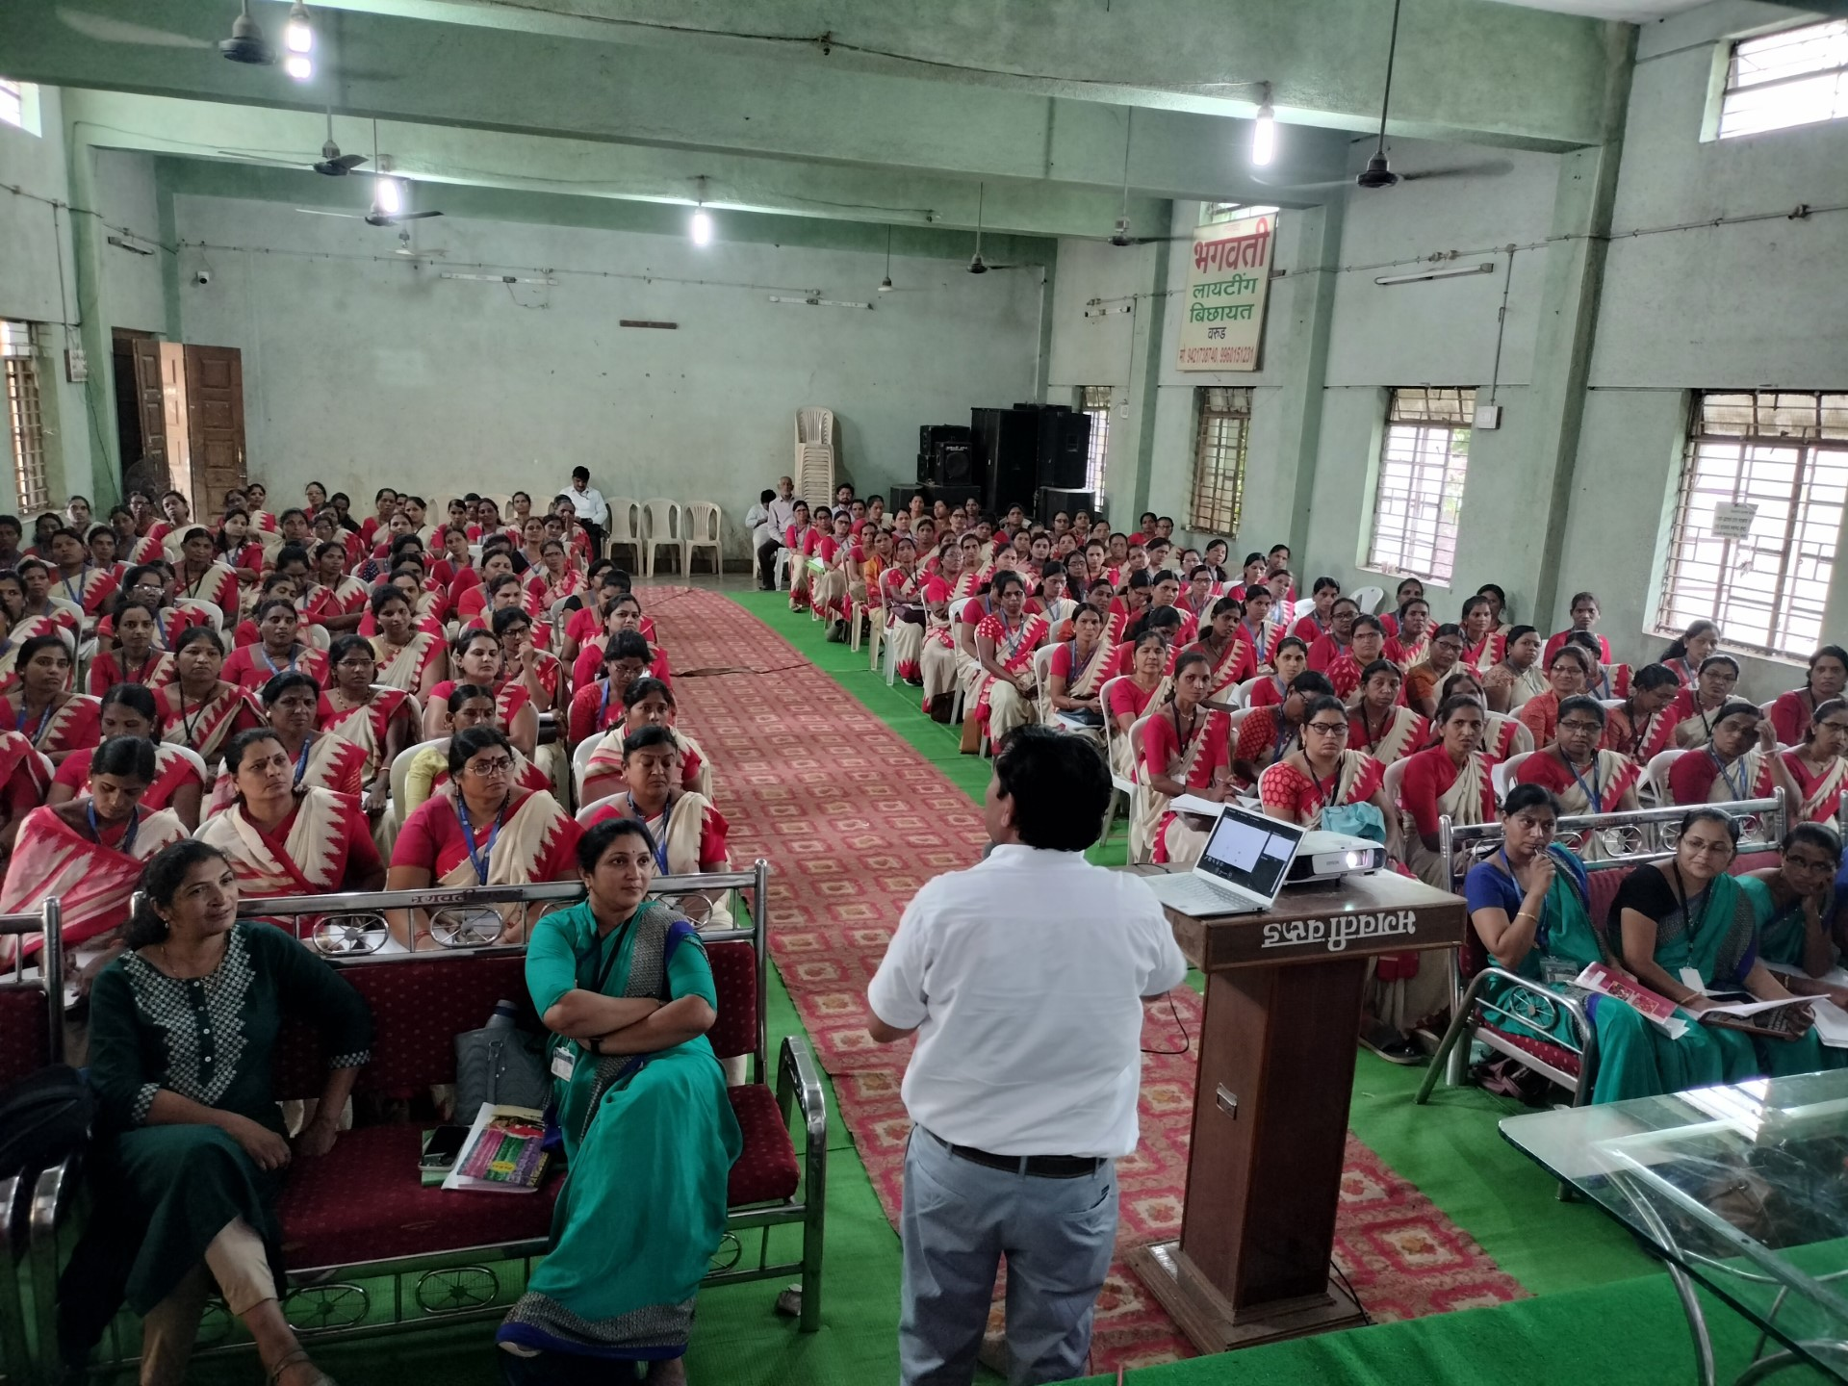
Thank you

