Slide 1
Collaborative efforts among NLEP, NTEP, and the Rogi Sahayata Kendra for MDT adherence
Bankura, West Bengal
Dr. Arup Chakrabartty, SPL, NLR India Foundation

Slide 2
Background
COVID 19 pandemic taught us multi-tasking and extensive collaborative efforts.
There are potential capacity at the facility level at block, Rogi Sahayaks under the Rogi Sahayata Kendra (‘May I Help You !’ desk) having two persons dedicated for patient well-being through interactive activities with patient and party.
Momentum of National TB Elimination Programme, aiming TB elimination by 2025 (NSP – NTEP 2020-25) can be leveraged to bring synergy with National Leprosy Eradication Programme (NLEP) that also aims to accelerate towards achieving interruption of leprosy transmission in India by 2027 (NSP-NLEP 2023-27).
Strengthening of MDT adherence through collaboration is an opportunity.

Slide 3

Background
To interrupt the transmission of leprosy, we need:
To detect new cases early
Provide full treatment as per guidelines
Trace contact and administer preventive therapy
If treatment is not regular and complete (including management of drug side effects and lepra reactions),
it adds to the burden of:
Disability
Relapse
AMR
Increased transmission
Increased out of pocket expenditures

Slide 4
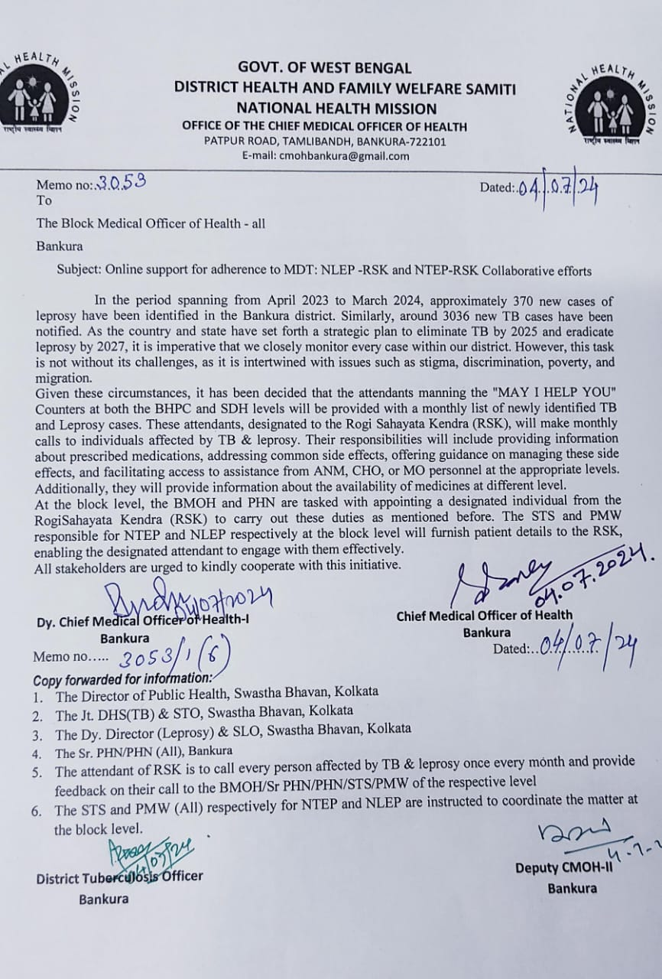
Collaborative efforts NLEP-NTEP-Rogi Sayayata Kendras
This collaborative model unites NLEP, NTEP, and RSKs.
Officially launched in July 2024, the initiative was facilitated by the Chief Medical Officer of Health (CMOH), Dy CMOHs, District TB Officer (DTO), District Leprosy Officer (DLO) & SPL, NLR India (West Bengal)

Slide 5
Input for this collaboration
Training of Rogi Sahayak (RS) from Rogi Sahayata Kendra, Para Medical Worker (PMW) from NLEP and Senior Technical Supervisor (STS) from NTEP
Training Flyer (as provided by state for ASHA)
Introductory note for RS to introduce to leprosy affected persons (Bengali & English)
Checklist for patient interaction
Standard Operating Procedure
Online review meeting – BMOH, Sr PHN/PHN, RS, PMW, STS facilitated by CMOH, Dy CMHO 1, Dy CMHO 2, DTO, MODNT
Strengthening Patient Follow-Up and MDT Adherence Monitoring

Slide 6
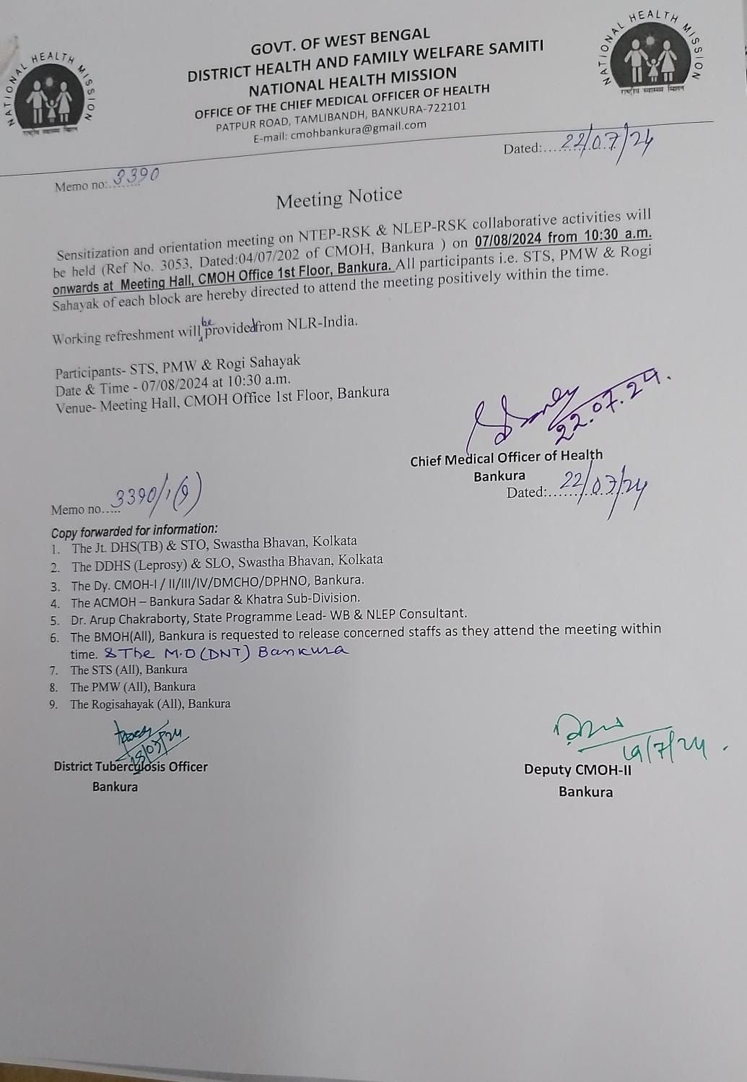
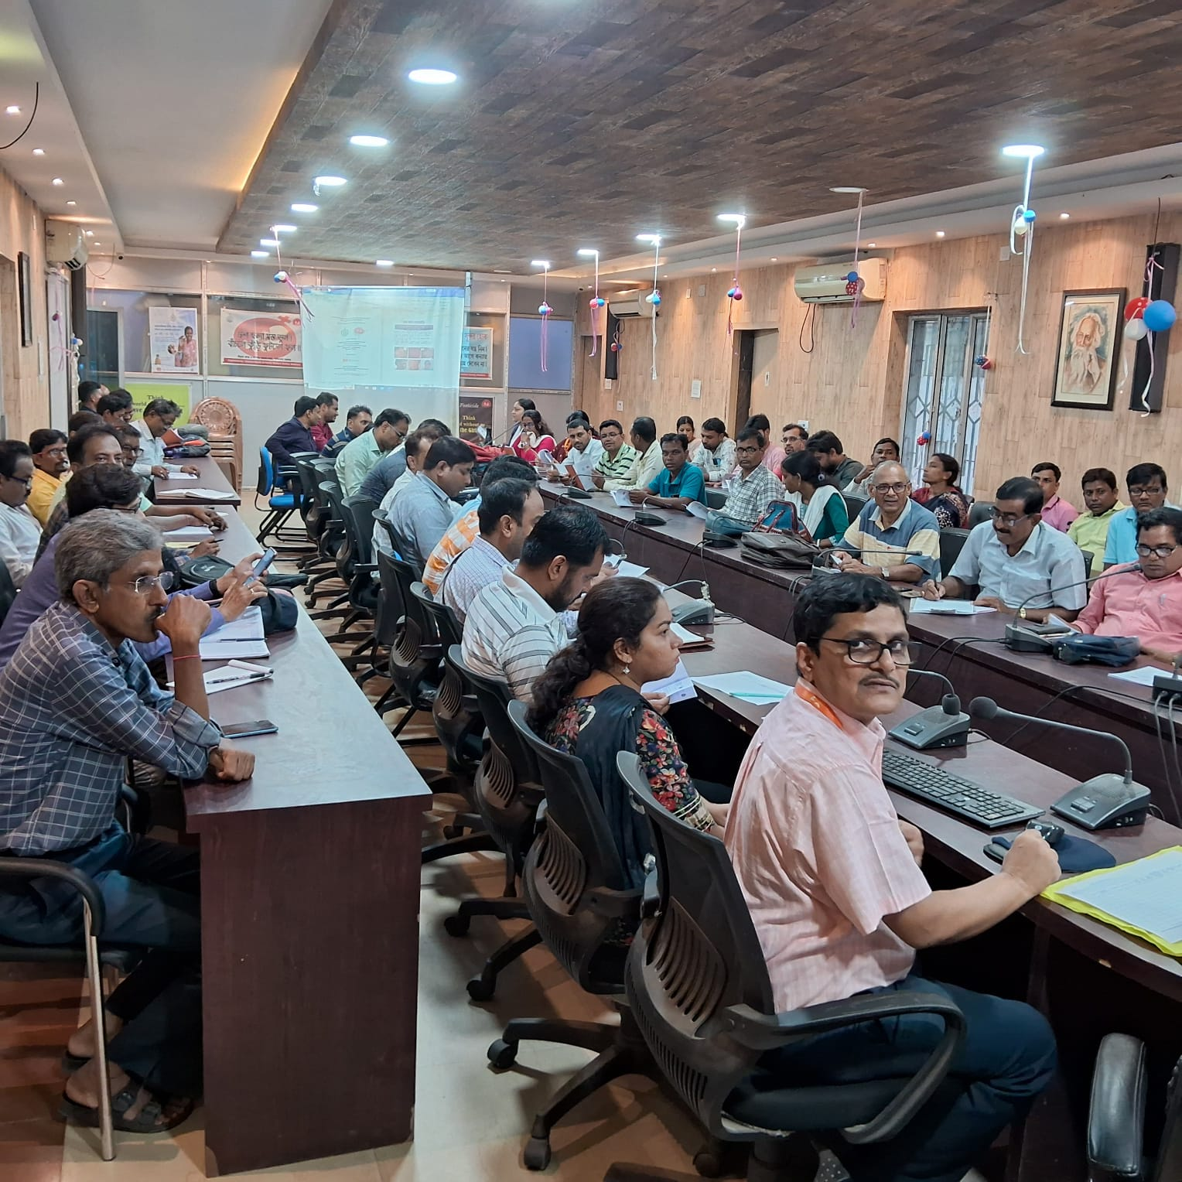
Training of Rogi Sahayak (RS), PMW and STS
Training of 68 Rogi Sahayaks from Rogi Sahayata Kendra (RSK), PMWs from NLEP and STS from NTEP on 07/08/2024
  Basics of leprosy & TB
  Introductory note for patient interaction
  SOP for the project
  Reporting

Slide 7

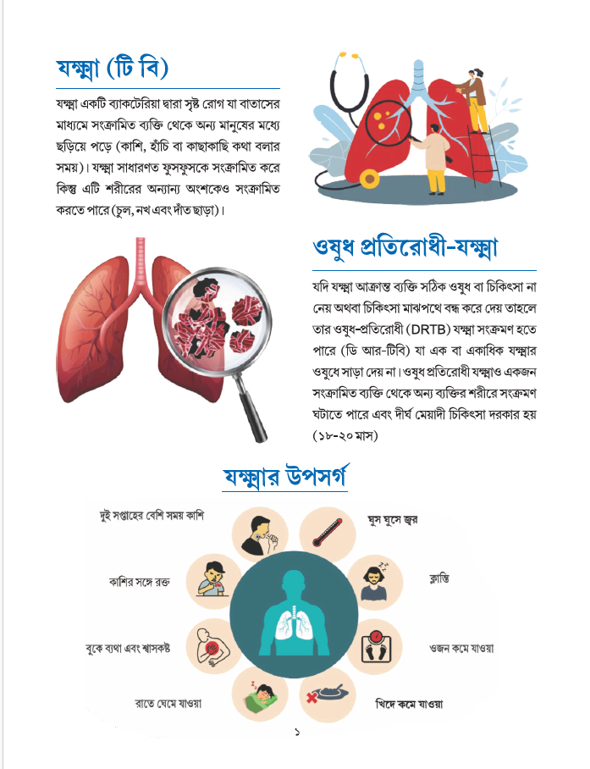
Training Flyer (as provided by state for ASHA)

Slide 8
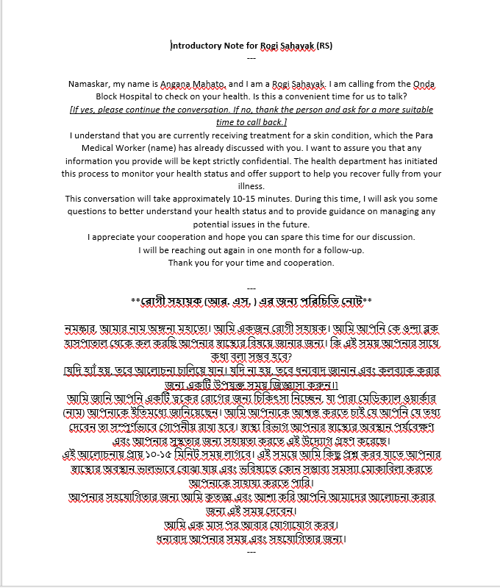
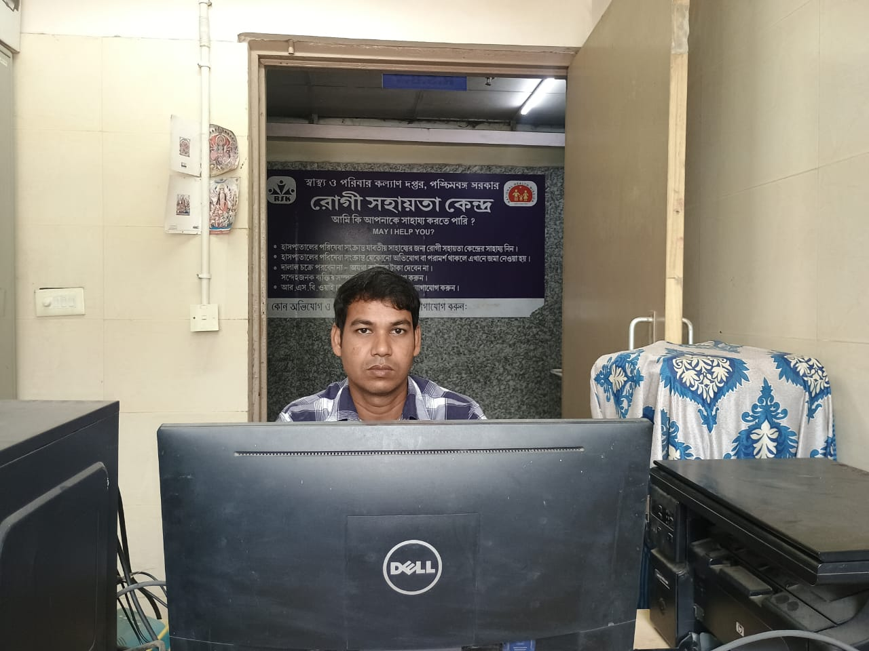
Introductory note for RS to introduce to leprosy affected persons (Bengali & English)

Slide 9
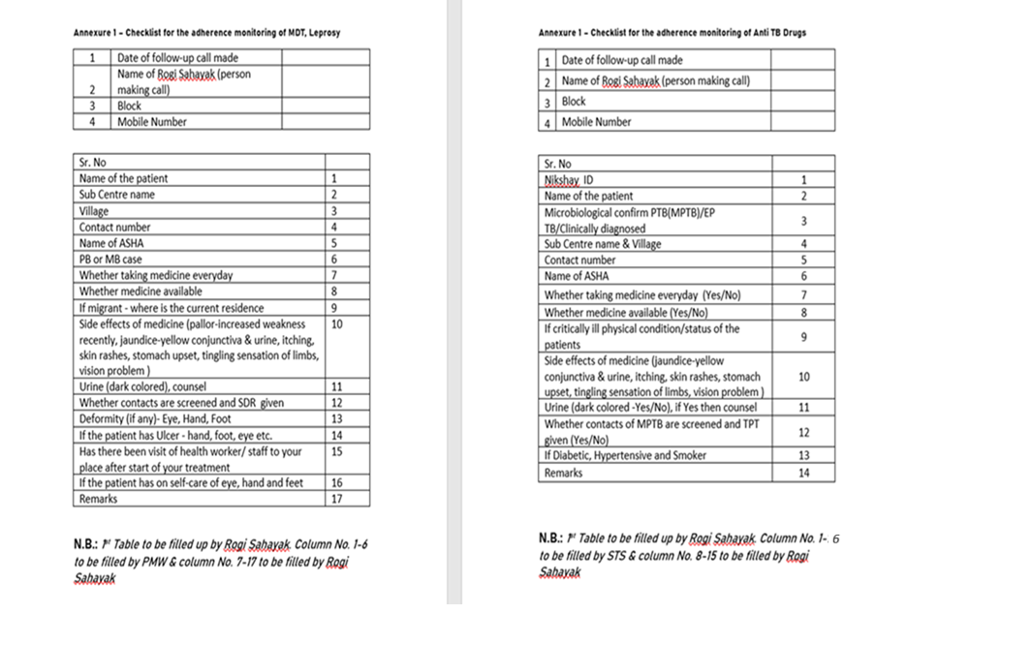
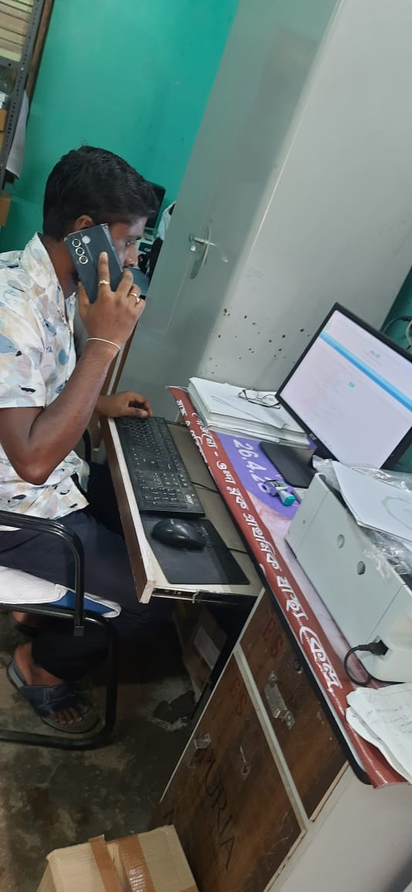
Checklist for patient interaction

Slide 10
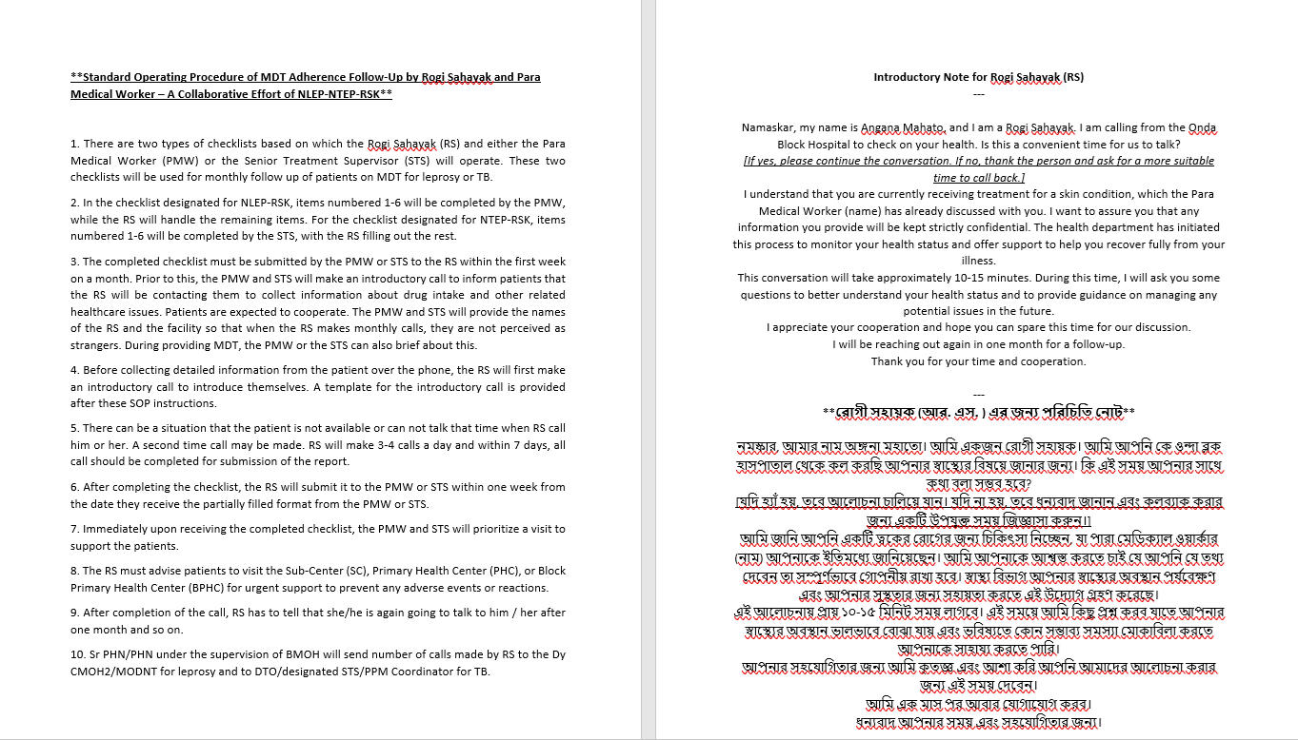
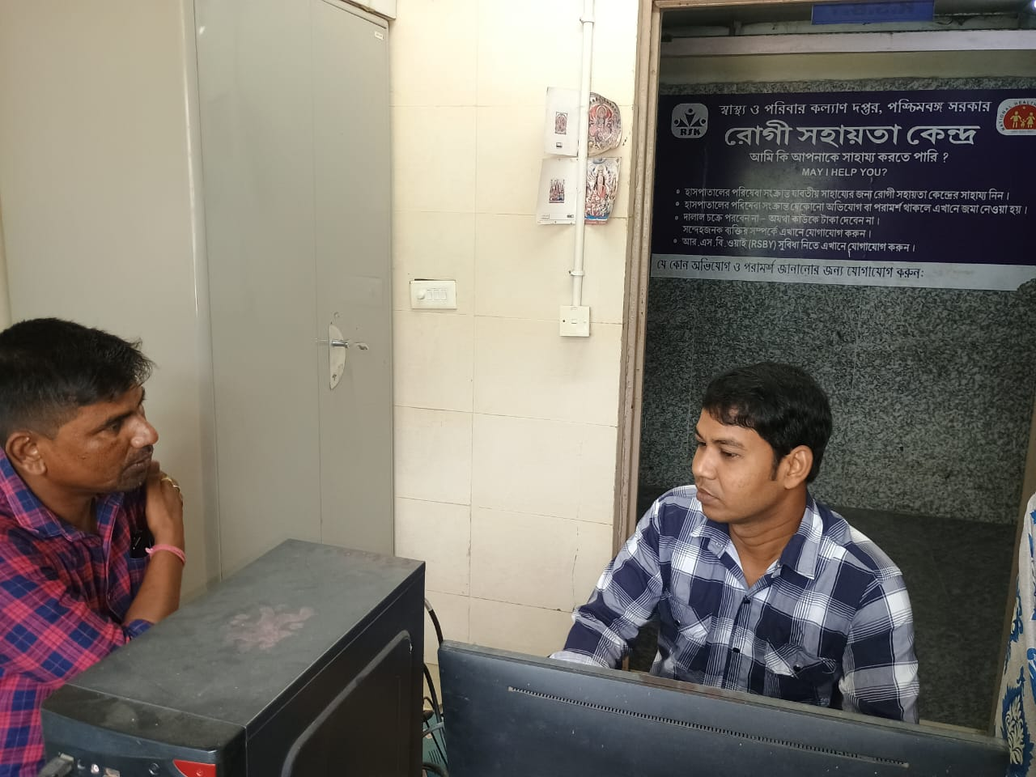
Standard Operating Procedure

Slide 11
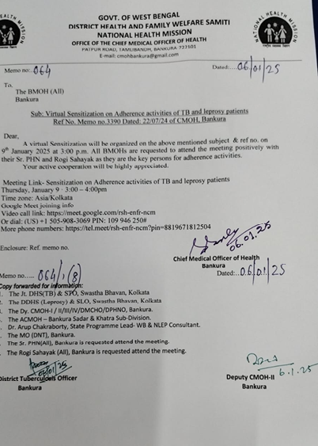
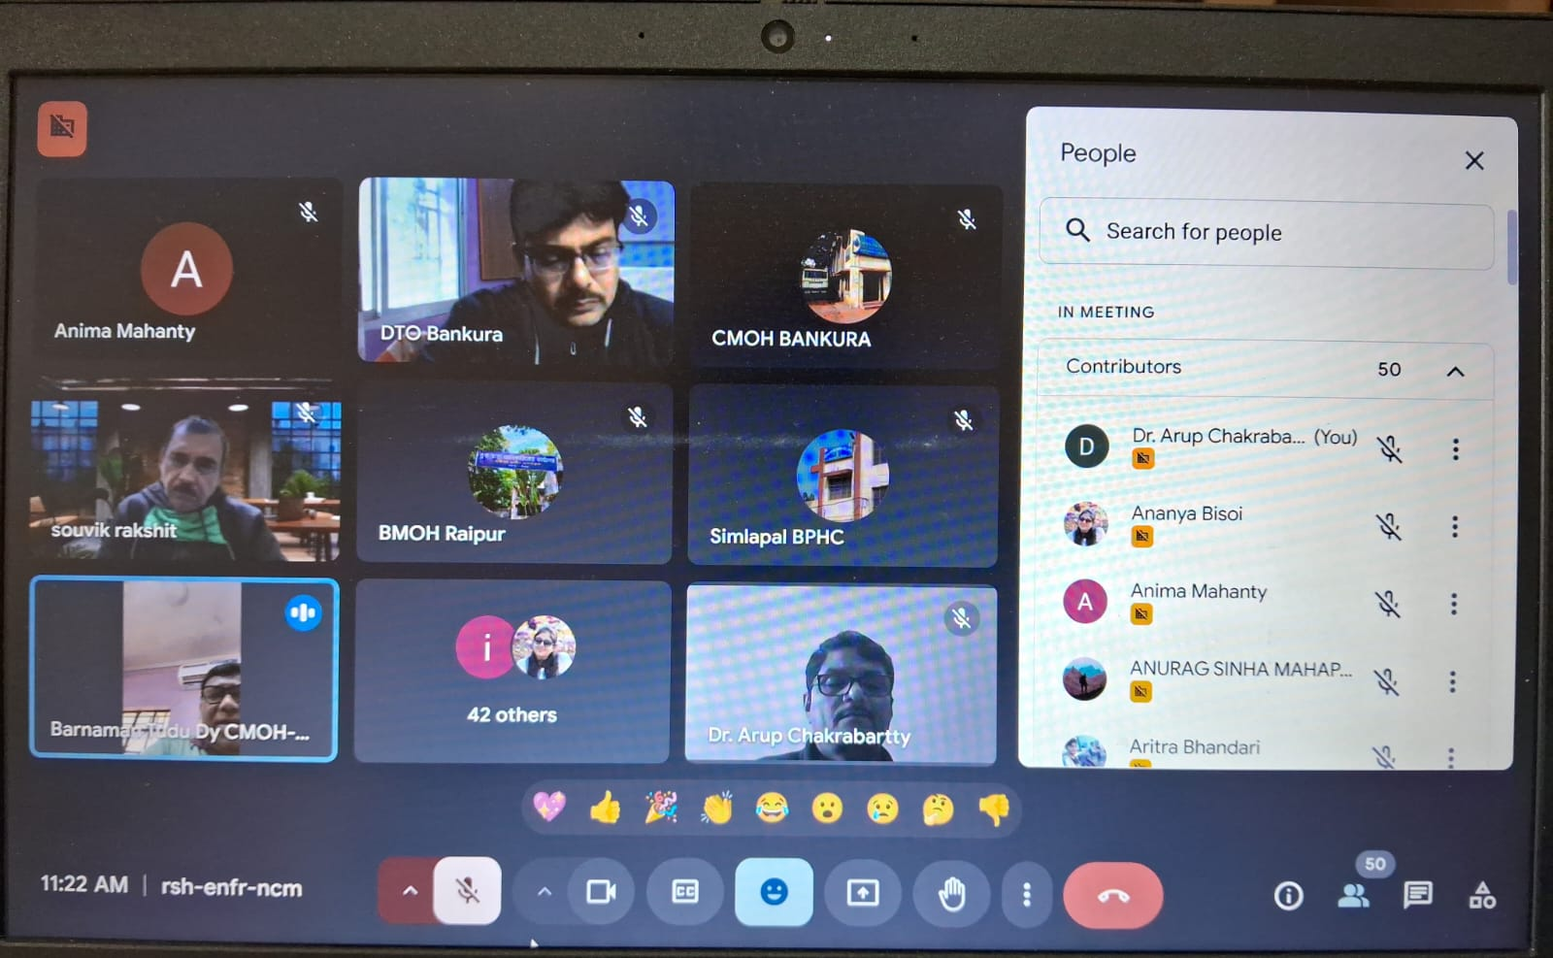
Online review meeting – BMOH, Sr PHN/PHN, RS, PMW, STS facilitated by CMOH, Dy CMHO 1, Dy CMHO 2, DTO, MODNT
Sensitization meeting with Rogi Sahayaks, PMWs, BMOH, PHNs of 16 blocks in Bankura facilitated by CMOH, Dy CMOH 1, DLO, MODNT, DTO of Bankura apart from SPL, West Bengal on 09/01/2025

Slide 12
Strengthening Patient Follow-Up and MDT Adherence Monitoring
Structured Follow-Up:
At the beginning of each month, PMWs shared lists of MDT patients with RS, who began contacting them. A simple checklist guided patient interaction, and RS submitted reports to PHNs or PMWs. Based on responses, support was delivered through ASHA home visits, PMW’s priority visit, or referrals to health facilities.
Direct Support Access:
Patients received RS contact numbers, enabling them to report side effects, drug reactions, or emotional distress directly. This open channel built patient trust and ensured timely interventions.
Community Confidence:
The model empowered patients to take active roles in their treatment. ASHAs, previously less involved in follow-up, became more accountable and responsive due to heightened community expectations.

Slide 13
Results
The follow-up mechanism is now active across all 16 blocks.
From January to March 2025, 208 leprosy patients were monitored biweekly.
The model also extended to select TB such as pediatric TB, drug-resistant TB, and cases requiring intensive follow-up, with RS support guided by STS and DTO.

Slide 14
Results (Jan – March 2025)
# |  | Functional ? July 2024 | Functional ? Jan 2025 | Functional ? April 2025 | Number of on MDT | Number contacted by Rogi Sahayak
1 | Ranibandh | No | Yes | Yes | 16 | 13
2 | Khatra | No | Yes | Yes | 14 | 14
3 | Raipur | No | Yes | Yes | 4 | 4
4 | Sarenga | No | Yes | Yes | 20 | 20
5 | Simlapal | No | Yes | Yes | 15 | 15
6 | Taldangra | No | Yes | Yes | 5 | 5
7 | Hirbandh | No | Yes | Yes | 16 | 16
8 | Indpur | No | Yes | Yes | 17 | 17
9 | Anchuri | No | Yes | Yes | 17 | 17
10 | Chatna | No | Yes | Yes | 17 | 15
11 | Saltora | No | Yes | Yes | 14 | 13
12 | Kanchanpur | No | Yes | Yes | 9 | 9
13 | Amarkanan | No | Yes | Yes | 9 | 9
14 | Mejia | No | Yes | Yes | 13 | 13
15 | Barjora | No | Yes | Yes | 8 | 8
16 | Onda | No | Yes | Yes | 20 | 20
 | TOTAL |  |  |  | 214 | 208

Slide 15
Qualitative observations
Improved Coordination: Enhanced tri-party communication among patients, RS, and PMWs improved continuity of care and minimized gaps in treatment.
Extended Coverage: RS involvement reduced PMW workload, allowed monitoring of RFT and post-treatment patients, and improved management of adverse drug reactions and lepra reactions.
Patient Empowerment: Patients increasingly initiated contact with RS or PMWs, signaling a cultural shift toward self-advocacy and proactive care-seeking behavior.
Strengthened PHN Role: PHNs now play a pivotal role in data coordination and field action planning, bridging communication between RS and frontline workers.
Efficient Home Visits: Despite limited mobility funds, shared field responsibilities between RS and PMWs ensured that patient outreach continued uninterrupted.
NTEP Synergy: Similar positive outcomes were reported for TB patients, indicating the model’s versatility across programs.

Slide 16
Challenges
Initial resistance from some Rogi Sahayaks to take on new responsibilities, coupled with operational issues like unpaid mobile reimbursements and delayed salaries, temporarily affected their motivation and required intervention from senior officials to ensure participation.

Slide 17
Conclusion and Scalability
The Bankura model emphasizes on system strengthening for efficient operationalization of the NLEP implementation.
Impact indicators like reduction of disability, treatment completion rate, LPEP coverage, reduction in delay in care during lepra reaction etc. – yet to be established.
It enhances treatment adherence, patient satisfaction, and program coordination without demanding substantial new resources.
The model exemplifies a cost-effective, replicable approach that leverages existing frontline health infrastructure for integrated leprosy and TB care.
With improvements, such as incentive structures for RS and simple user friendly tools, and shared responsibilities between programmes, this model holds strong potential for scale-up across other districts and states to reinforce both NLEP and NTEP outcomes.

Slide 18
Thank you

