Slide 1










Orthotic Management in Leprosy
By
Mr. Bijoy Kumar Swain,
NLEP Consultant for Haryana & Chandigarh
Swiss Emmaus India

Slide 2
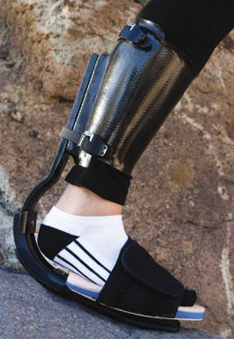

Orthotics Overview
Orthotics implies the technology for mechanical correction of orthopaedic deformities, realignment, redirection of lines of forces in the body, support of weak parts, prevention of undesirable movement, relieving weight borne by body parts, etc.
Mechanical Correction
  Orthotics technology is used for mechanical correction of orthopedic deformities to improve body functions.
Support Weak Parts
  Orthotics provide support to weakened body parts, helping to prevent undesirable movements and enhance stability.
Force Redirection
  Orthotics help in realignment and redirection of forces within the body, contributing to better posture and movement.
Relieve Weight
  Orthotics relieve the weight borne by certain body parts, reducing stress and promoting healing.
Notes:
What is an orthosis,
how this is useful in treating conditions in Leprosy

Slide 3
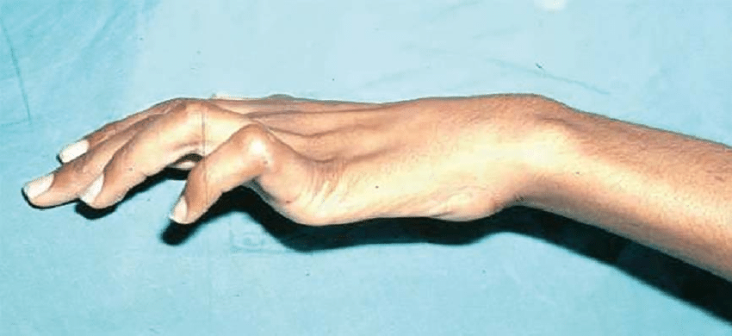
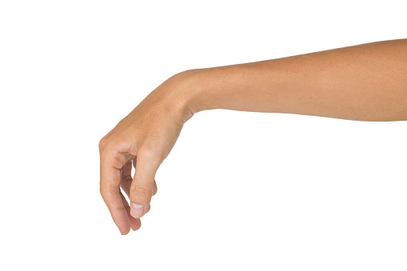
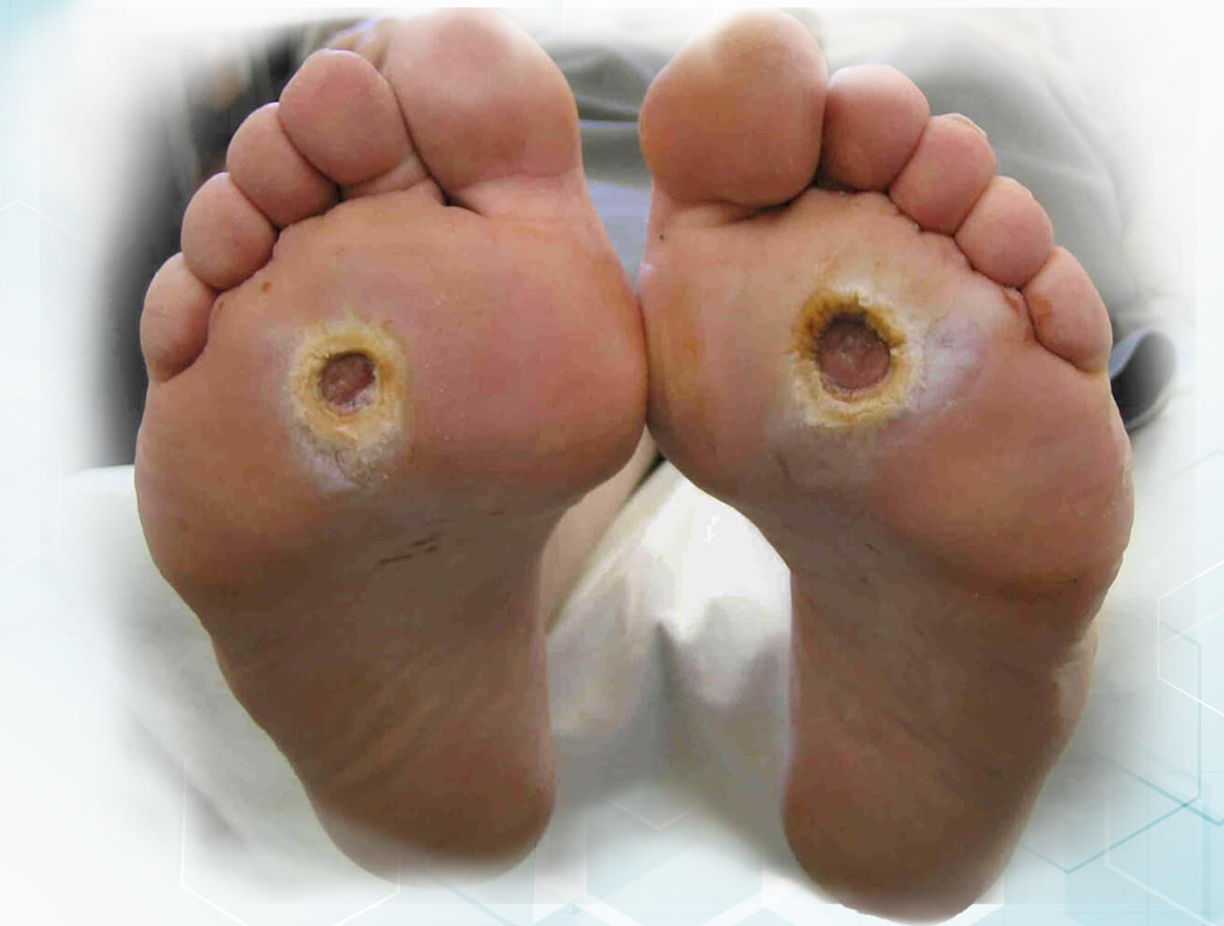
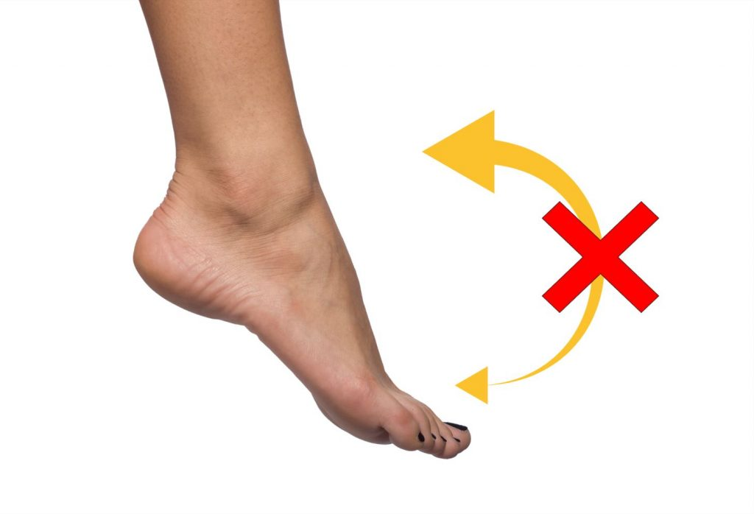
The common conditions in Leprosy need Orthotic Management
Clawing of finger/s
Wrist drop
Ulcer in foot
Footdrop

Slide 4
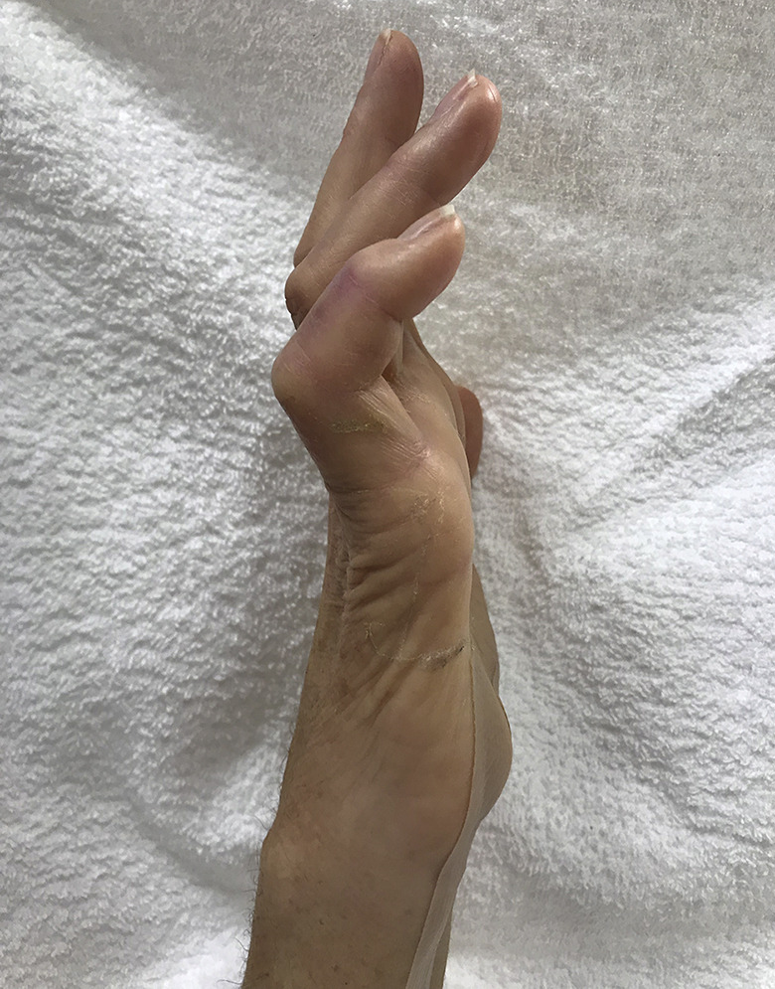
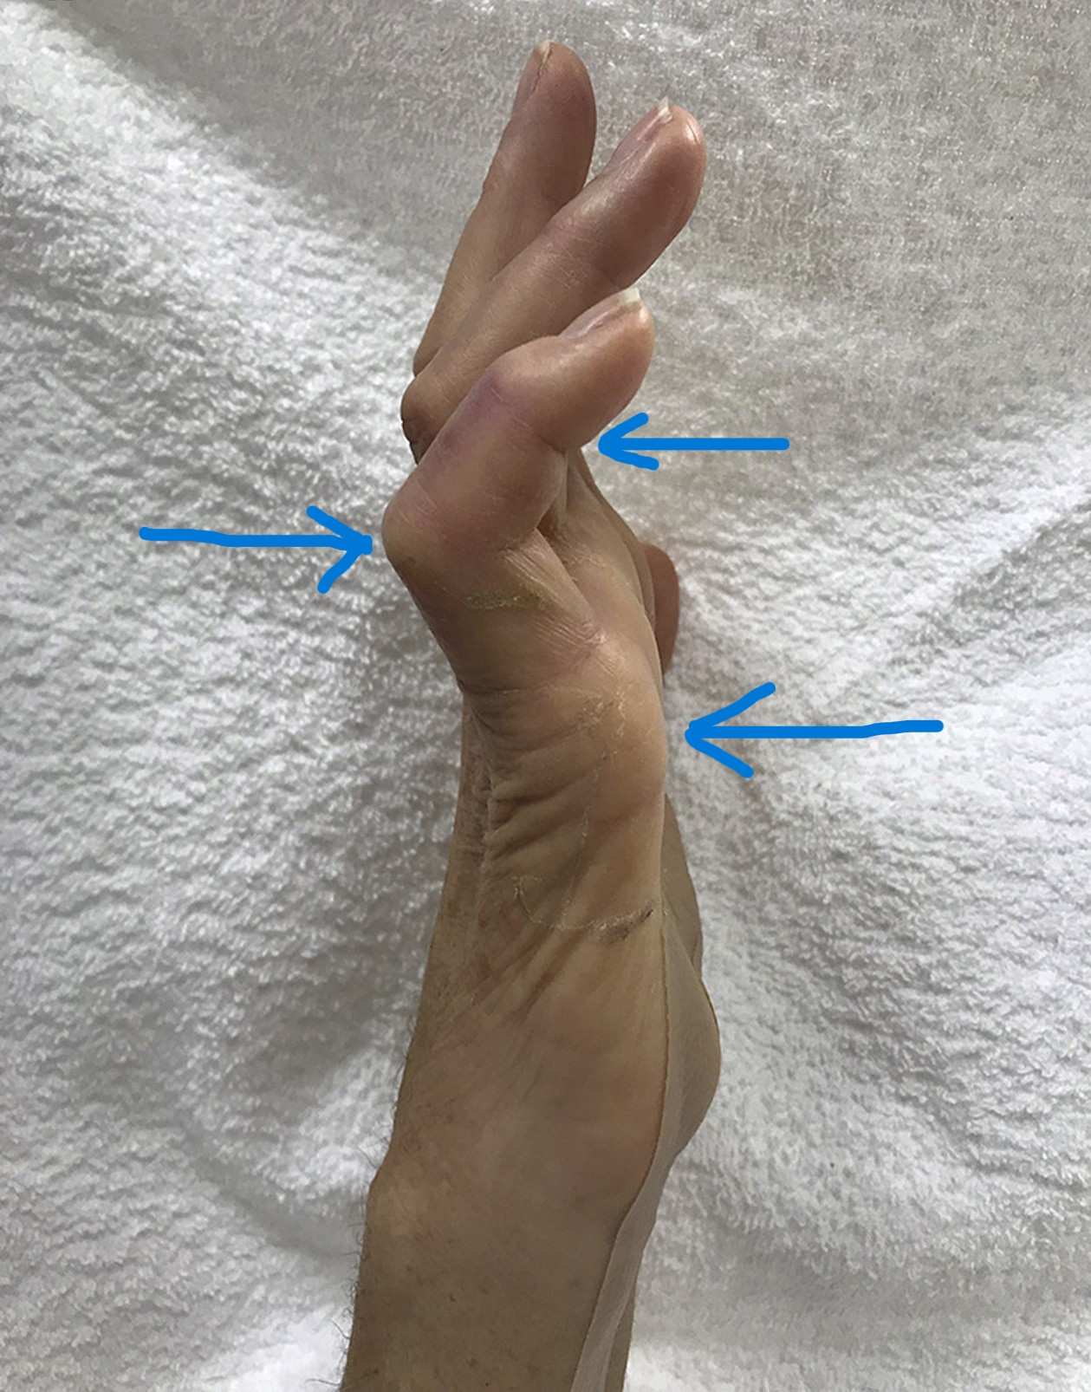
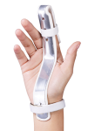
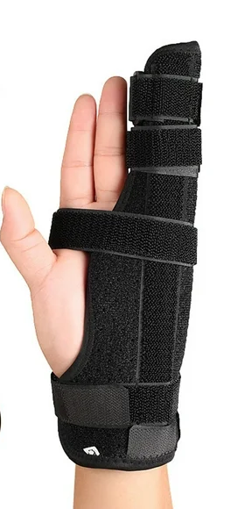

The orthoses used for conditions in Leprosy in Upper limb
3 point pressure system for correction
Splints
Claw Hand

Slide 5
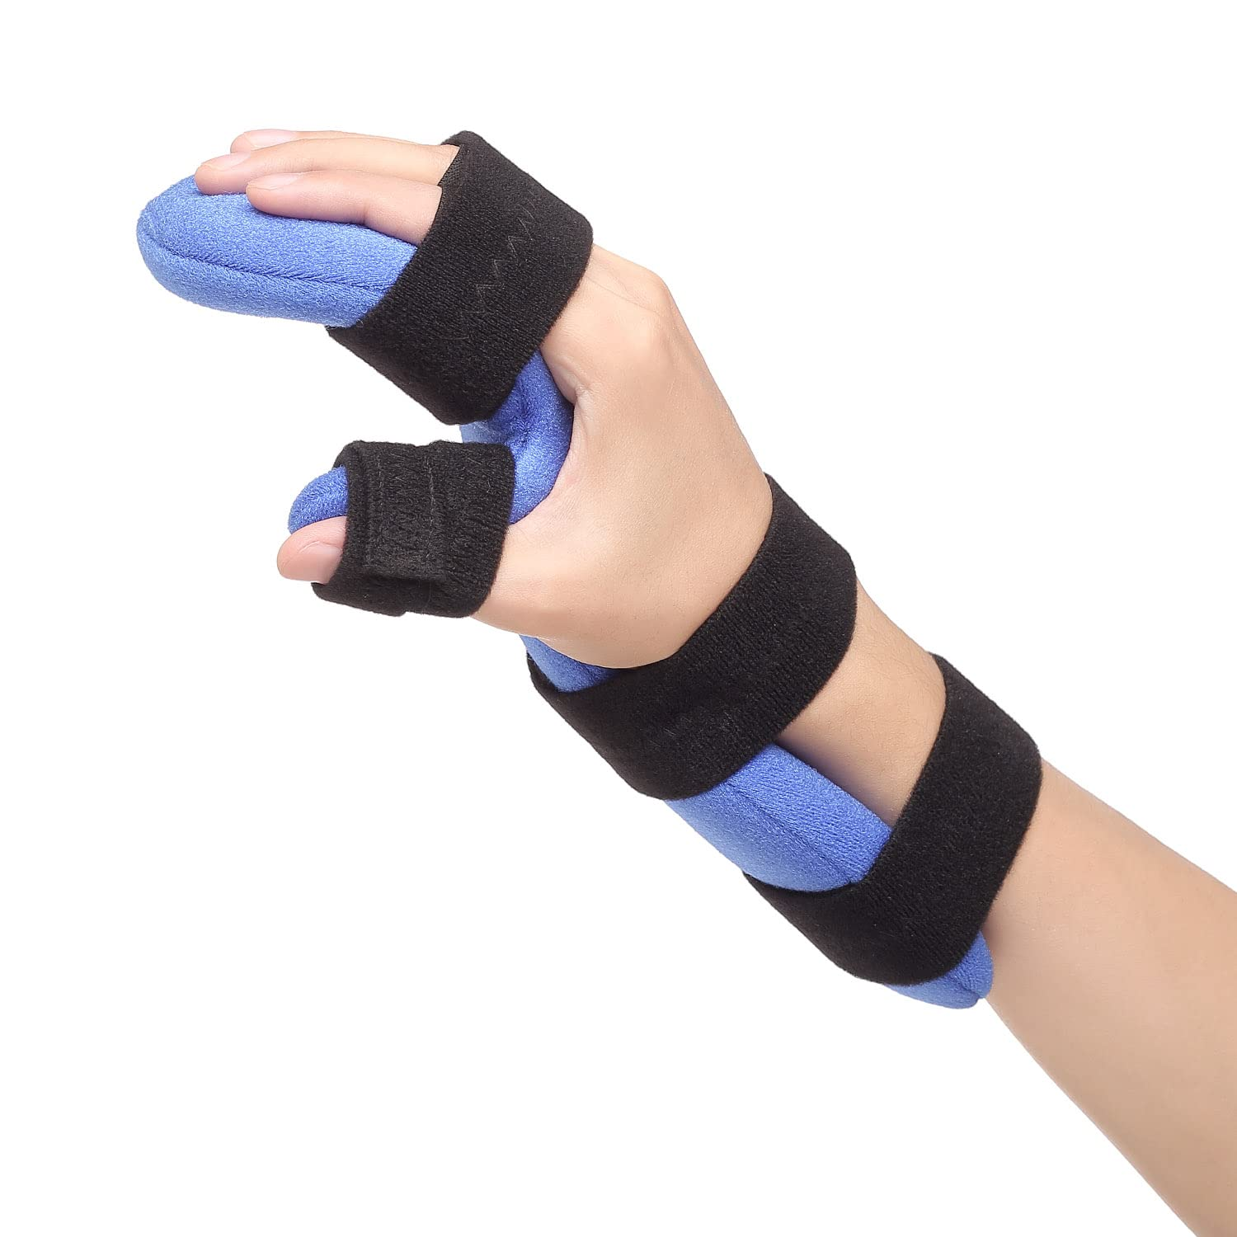
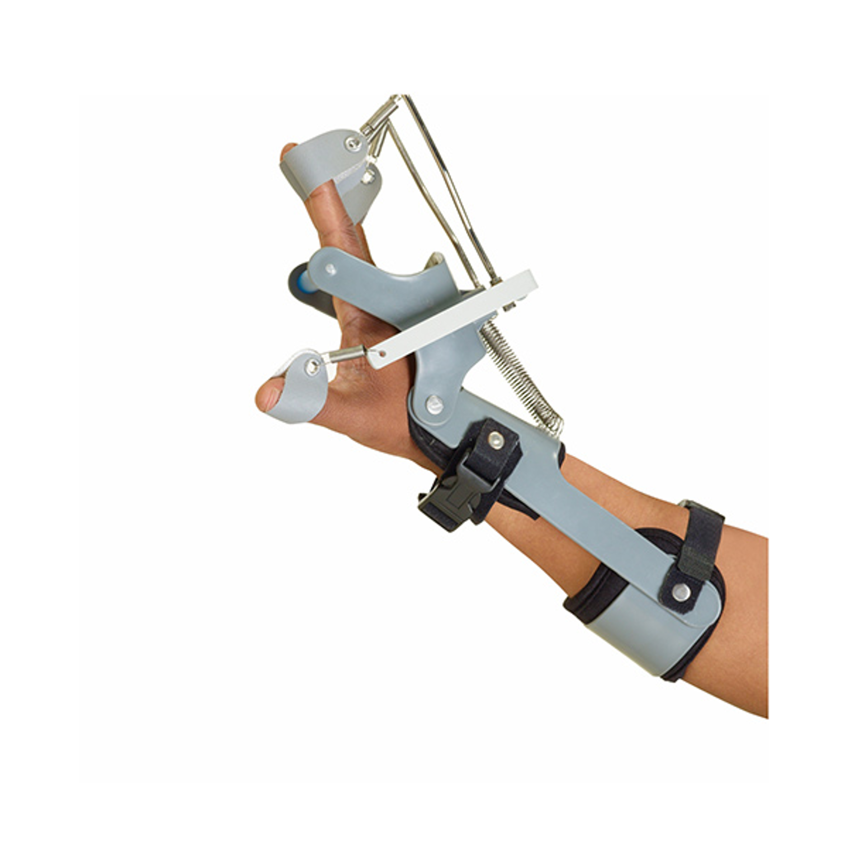
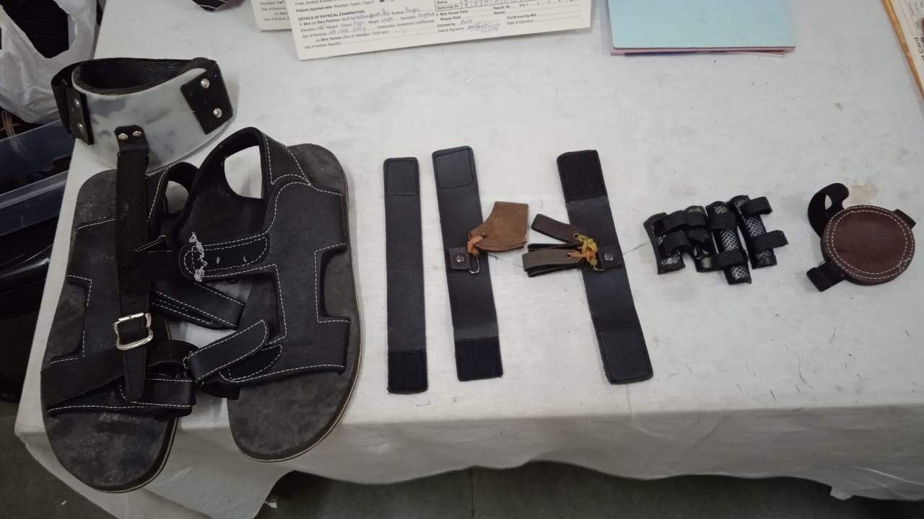
The orthoses used for conditions in Leprosy contd……
Wrist Drop
Dynamic Splint
Static Splint

Slide 6
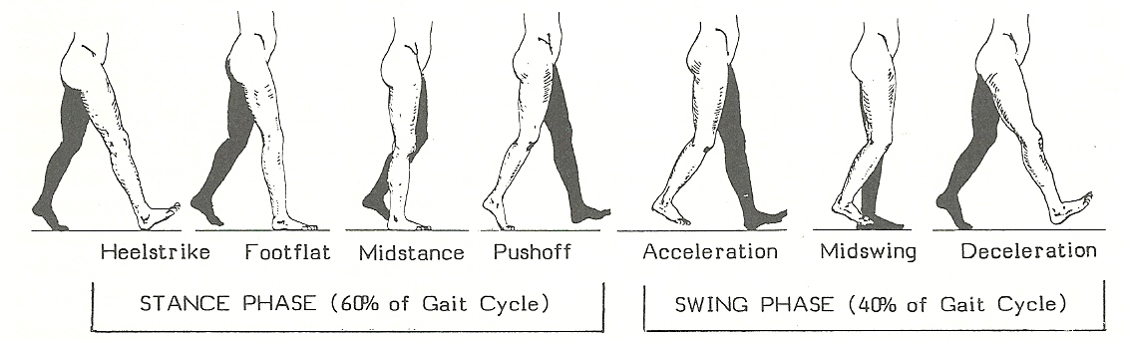
The orthoses used for conditions in Leprosy in Lower limb
In normal standing position, do we know that 60% of our body weight falls on the heel and rest 40% over the Metatarsals and Toes

Slide 7
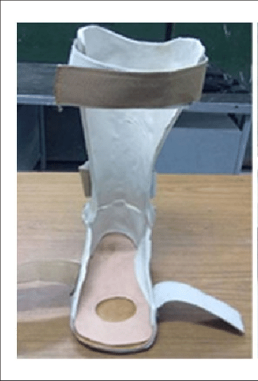
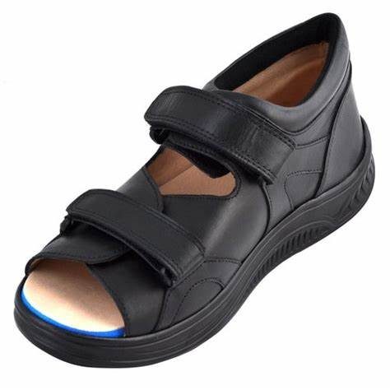
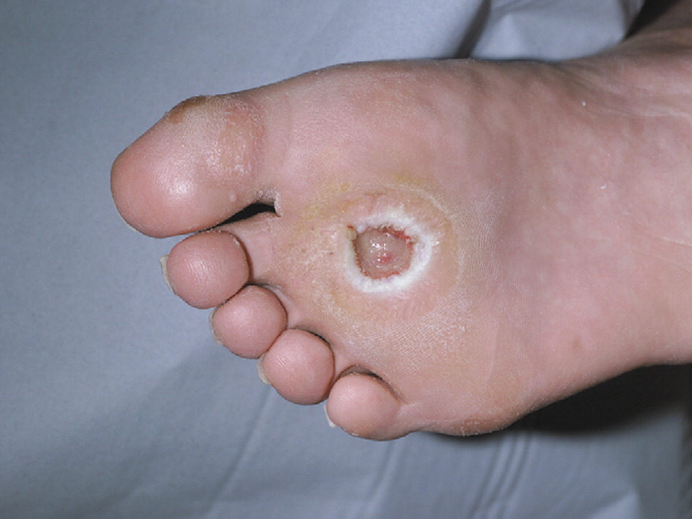
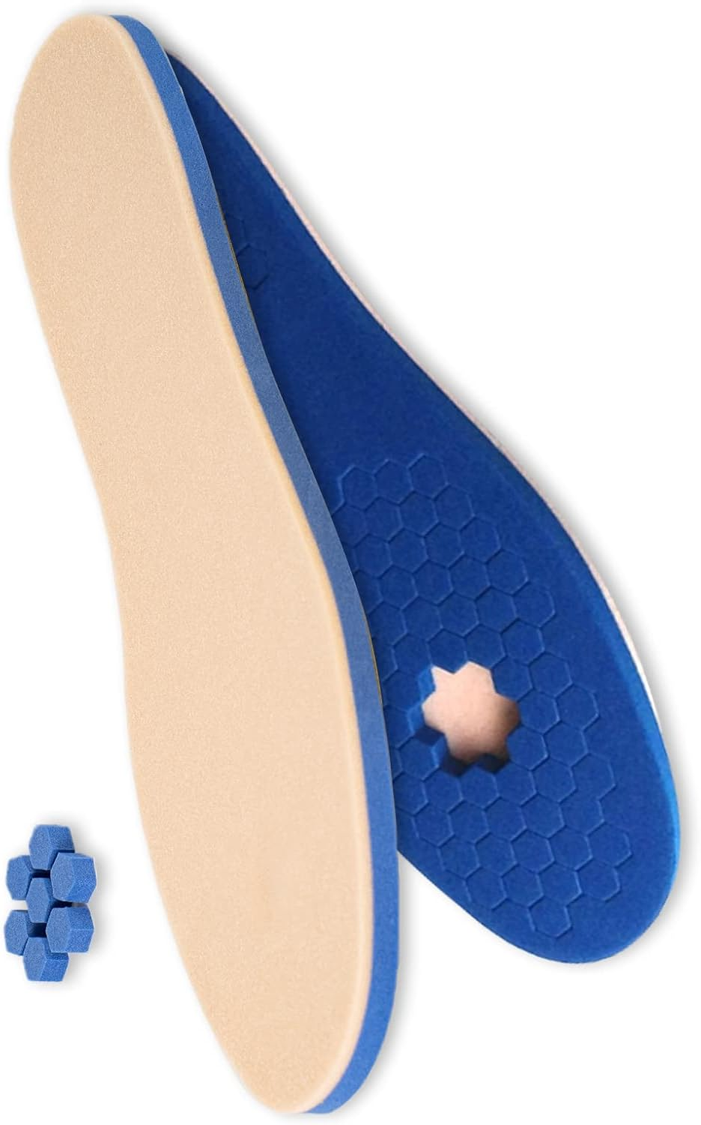
The orthoses used for conditions in Leprosy in Lower limb
Foot Ulcer
Pressure relieving Insole
Modified shoe
Pressure relieving orthosis

Slide 8
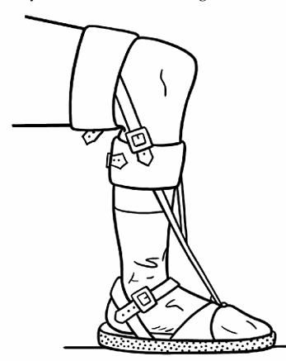
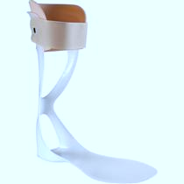
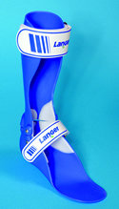
The orthoses used for conditions in Leprosy in Lower limb
Foot Drop
Modern Foot drop splint
Conventional Foot drop splint

Slide 9
Availability of Orthoses
Availability of Orthotic Appliances
Government Sector
National Institutes
NGOs
Non-Government
Private Practitioners
Public Sector, GoI ALIMCO

Slide 10
Details of Government Institutions providing Aids/Appliances
10 National Institutes
25 CRCs(Composite Regional Centres) for Skill Development, Rehabilitation & Empowerment of Persons with Disabilities
108 DDRCs in India
National Institutes | Department of Empowerment of Persons with Disabilities (DEPwD) | Home | India
National Institutes | Department of Empowerment of Persons with Disabilities (DEPwD) | Home | India
ADIP | Department of Empowerment of Persons with Disabilities (DEPwD) | Home | India
https://punarbhava.in/index.php/resources/institutions/district-disability-rehabilitation-centres

Slide 11
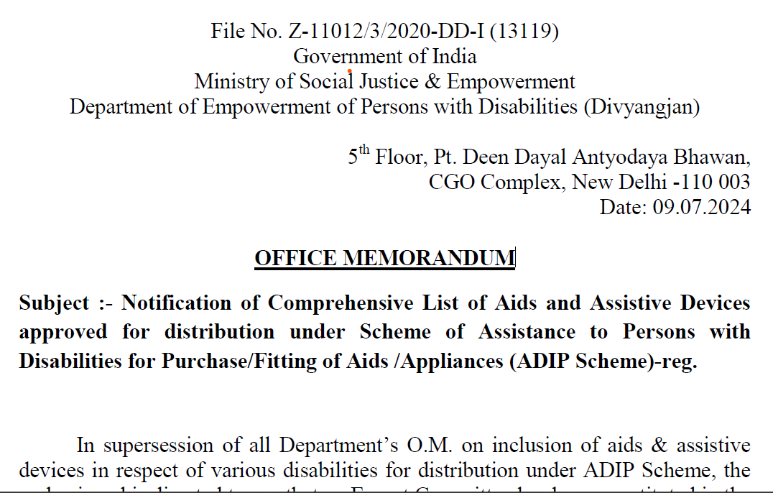
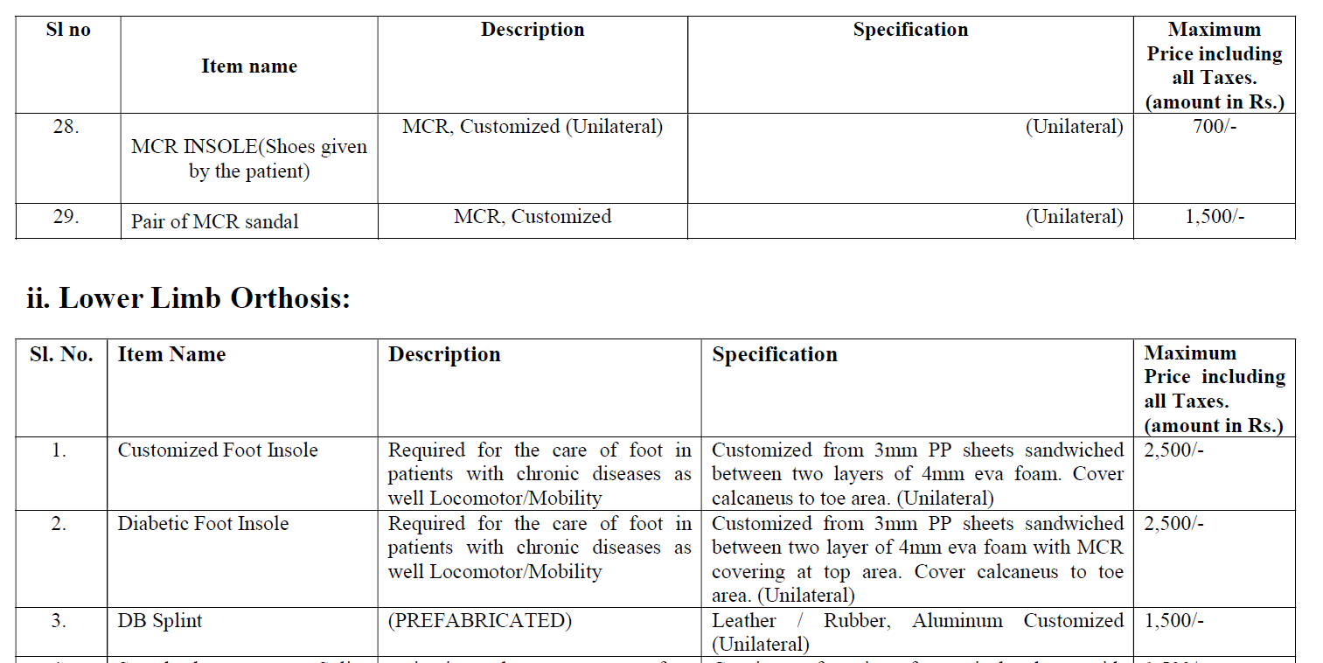
Govt. Notification on Aids & Appliances under ADIP Scheme
Notification of Comprehensive List of Aids and Assistive Devices.pdf
Collaborate with Departments and make sure people access the benefits

Slide 13
THANK YOU

