Slide 1












"Strengthening the Referral System to Provide Seamless Disability Prevention & Medical Rehabilitation (DPMR), and Social Rehabilitation Services Across 28 Districts of Bihar"
By
Dr. Sarbartha Roy,
NLEP Consultant for Bihar
Damien Foundation India Trust

Slide 2
Introduction:
Leprosy is a chronic infectious disease – affects primarily the peripheral nerves and skin, leading to disabilities
And deformities in the face, upper and lower limbs.
Management of leprosy is complex – diagnosis and management of complications need good clinical skills among the
Health care providers, and also recording & reporting.
Prevention of disability (POD) and prevention of worsening of disabilities (PWOD) is a challenge due to the complexity in
Its management.
Disability prevention can be achieved by early identification of NFI (reaction) and proper management (steroids,
Immobilisation and physiotherapy).
Worsening of disabilities can be achieved by early start of self-care (SSOD, Footwear, appliances) and RCS, occupational change (LEP).
Strengthening the referral system, Primary – Secondary – Tertiary level, is very important to achieve both POD and PWOD

Slide 3
Introduction continued…
Leprosy is still a major public health problem in Bihar.
Bihar is contributing 12000 to 15000 new leprosy cases every year.
Disabilities among new cases are high.
Vertical staff are almost retired, and only 34 % (183/534) of blocks have PMWs.
Health care providers at the block and district levels were not confident in identifying and managing neuritis/reactions and other complications (before intervention).

Slide 4
Project objectives:
This project aims to provide seamless DPMR and social rehabilitation services in 28 districts of Bihar state.
The objective is to:
Strengthening referral system and services at primary, secondary, and tertiary level care.
Improving the skills of health staff in the identification of presumptive leprosy cases and diagnosis, identification of complications like reactions, nerve function impairment (NFI), and their management.
Improving patient counselling.
Facilitate medical rehabilitation like self-care, RCS, MCR, etc., social benefits like pension and livelihood enhancement support for income generation.

Slide 5
Strengthening DPMR services in 28 districts
Two tertiary level hospitals (TLM Muzaffarpur and DFIT Dehri On Sone
LEP for needy supported by DFIT
Primary level
(390 Block Level)
Referral system strengthening
Secondary level
(28 District Level)
Tertiary level
(2 in the state)
WhatsApp group for all the Secondary level and WhatsApp group for primary at every district level

Slide 6
Challenges in Disability Prevention….
Primary level (Block level) Challenges | Key Activities
Human resource | Identified 2 Nodal persons – 1 MO and 1 Non medical (PMW, Staff nurse, MPHW, Pharmacist, STS, Group D etc)
Diagnosis and management of leprosy - Difficult to diagnose cases (LL, Neuritis), other skin diseases and reactions (recurrent ENL, Neuritis) | Trained for 3 days with practical sessions (case examination and presentation) – sensory test, VMT/ST and recording the details (suspect register, patient cards, register, reaction register, disability register) & Patient referral forms
Skin smear facility | Trained – when and where to refer (Directory of nodal persons and contact numbers)
Identification of Neuritis and reaction and reaction management – counselling | Patient Information Cards – signs and symptoms of reaction/Neuritis Patients were given the Nodal person’s contact number
Attrition of Nodal persons | Arranging on the job training immediately and later arrange for 3 days training in the same year.

Slide 7
Challenges in Disability Prevention….
Secondary Level (District) Challenges | Key Activities
Human resource | Identified 2 Nodal persons – Physiotherapist and NMS/HE/PMW
Management of complications related to leprosy –diagnosis of difficult to diagnose cases, Lepra reactions, Chronic ulcers, Neuritis, identification and mobilising RCS cases to tertiary level | 5 days institutional training – Diagnosis and management of complications like recurrent neuritis, Skin smear technic, Measurement of Customised footwear, RCS eligibility and post operation follow up (3rd), Patient Information cards, Referral and feedback forms, Referral register, Directory)
Skin smear facility | Tools were given, transportation of smears to DFIT lab in Darbhanga – Courier charges.
Management of recurrent reactions, Neuritis, Physiotherapy, aids and appliances | Trained in immobilising limb (POP or readymade splints),
Attrition of trained nodal persons | Arranging on the job training immediately and later arrange for 5 days institutional training in the same year.
Support of other specialities like Skin, Eye, Ortho and general medicine – for managing specific complications. | One-to-one sensitised, Nodal person at the secondary level ties up with the Specialist at the district level

Slide 8
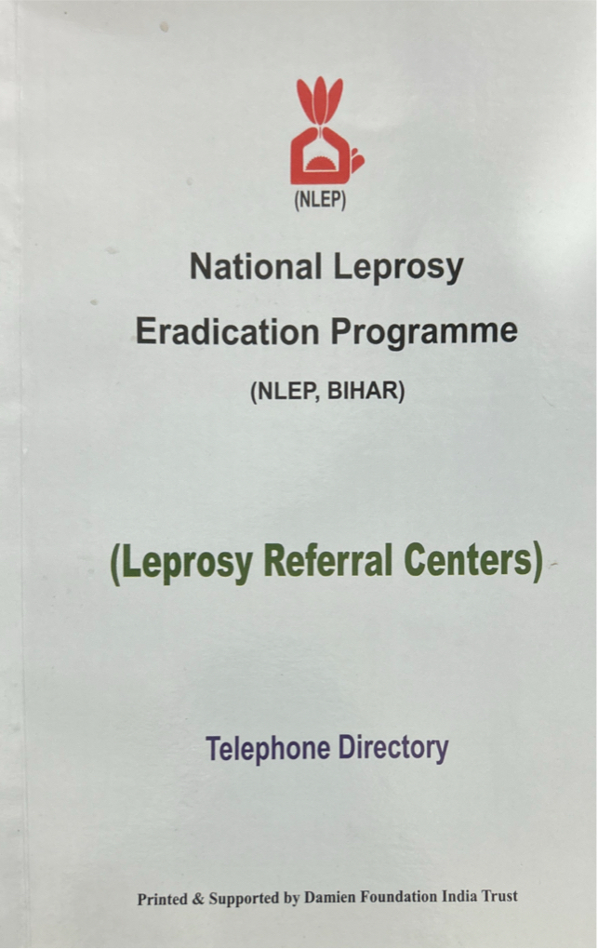
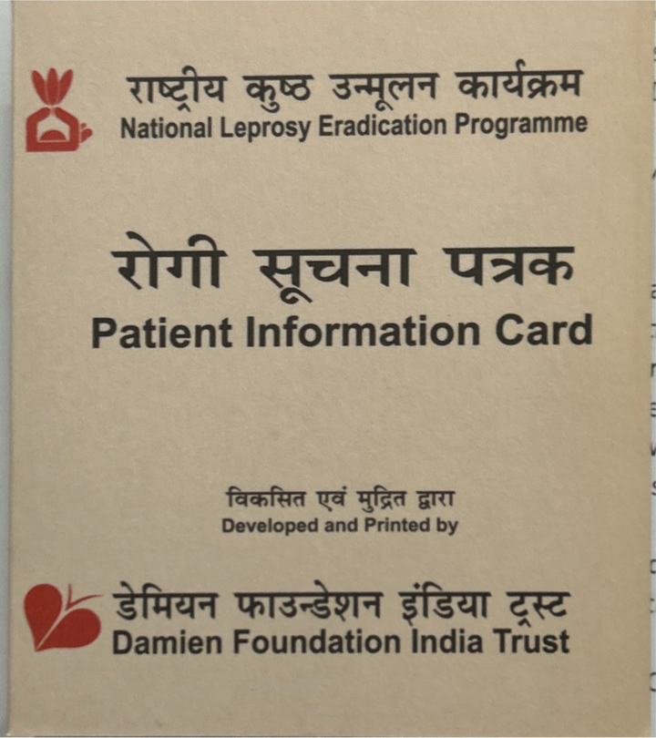
Patient Information Card
Telephone Directory

Slide 9
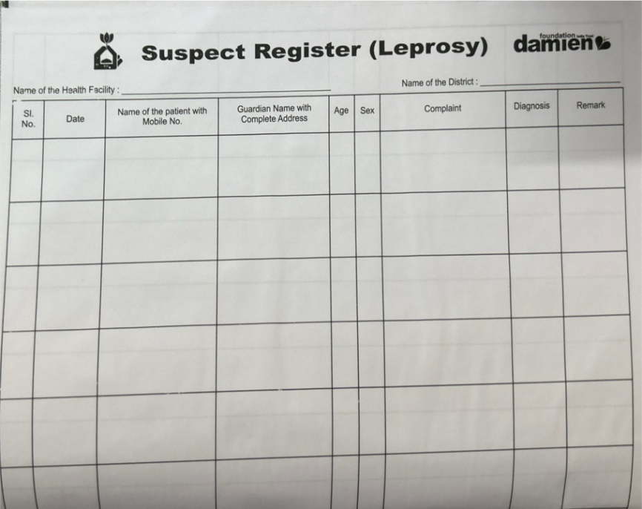
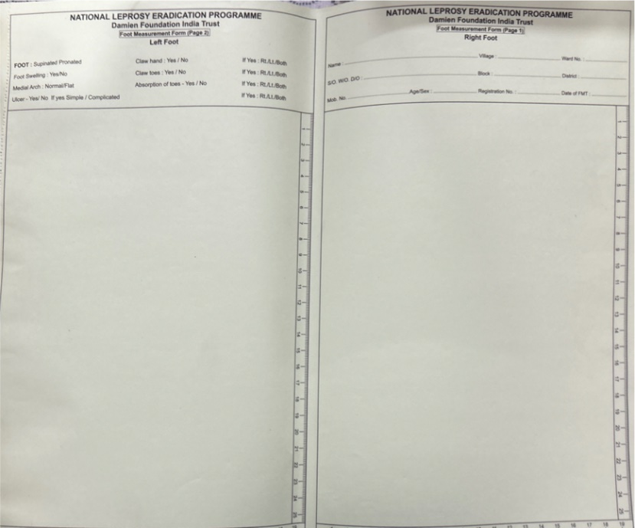
Suspect Register
Foot measurement Register

Slide 10
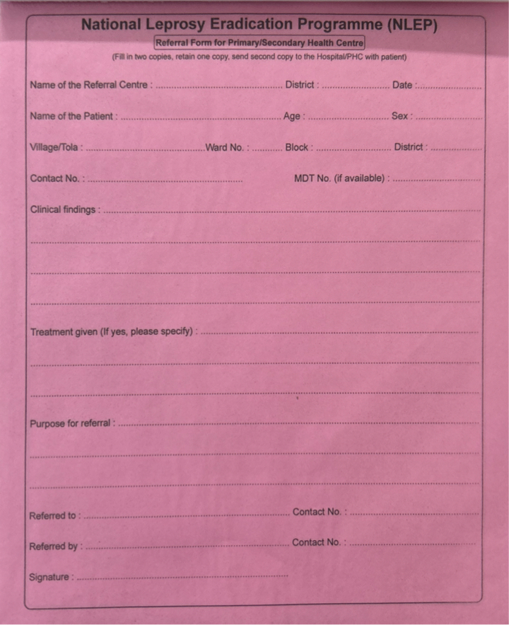
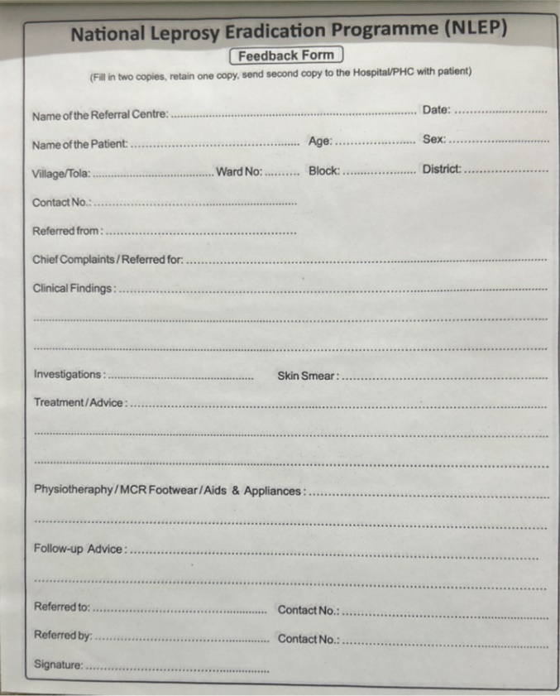
Feedback Form
Referral Form

Slide 11
Challenges in Medical Rehabilitation….
In the districts | Key Activities
List of persons affected by leprosy with disabilities (available/updated) | Assessment of disability status (RCS, MCR, Pension) and update the list – covered block wise by CSW – final list is available with primary (block) and secondary (district) level Block RCS Disability certificate for pension/other entitlements MCR footwear/ Customised MCR
Livelihood support for needy | Small business, education support, skill training etc
District
Tertiary level

Slide 12
Primary level (block) | 2021 | 2022 | 2023 | 2024
Total Number of Cases Referred to Secondary Level Referral Centre from Primary Level. | - | 1710 | 2397 | 1985
Number of PHC referred cases to Secondary level | - | 256/390 | 338/390 | 325/390
Secondary Level (district) | 2021 | 2022 | 2023 | 2024
Total Number of cases managed | - | 7799 | 10722 | 12195
New cases diagnosed | - | 2304 | 3014 | 3081
Number of new child cases NFA done | - | 523 | 654 | 522
Reaction case managed | - | 584 | 814 | 893
Ulcer cases managed | - | 507 | 647 | 873
Skin smear | - | 168 | 252 | 364
Customized footwear | - | 72 | 208 | 349
RCS referral | - | 104 | 125 | 116

Slide 13
Patients Attended the SLRC:

Slide 14
PLRC Referral:

Slide 15
New Case Detection:

Slide 16
Skin Smear:

Slide 17
Reactions Identified & Managed:

Slide 18
Child Case Assessment:

Slide 19
RCS Referral:

Slide 20
Customized Footwear:

Slide 21
Medical Rehabilitation
Activity | Bihar (Jan 2017-December 2024)
Total Number of G2D patients in the list at the time of implementation of the program (baseline) | 7498
No. Of G2D patients added to the list | 21951
No. Of G2D patients deleted from the list | 10166
Updated list of G2D patients at the end of 2024 | 18457 (all received training on Selfcare)
RCS eligible cases identified | 1372 (1046 got RCS)
Eligible for MCR | 10447
Eligible for livelihood support | 723 (520 received )
Eligible for Disability Certificates | 11759 (6615 received )

Slide 22
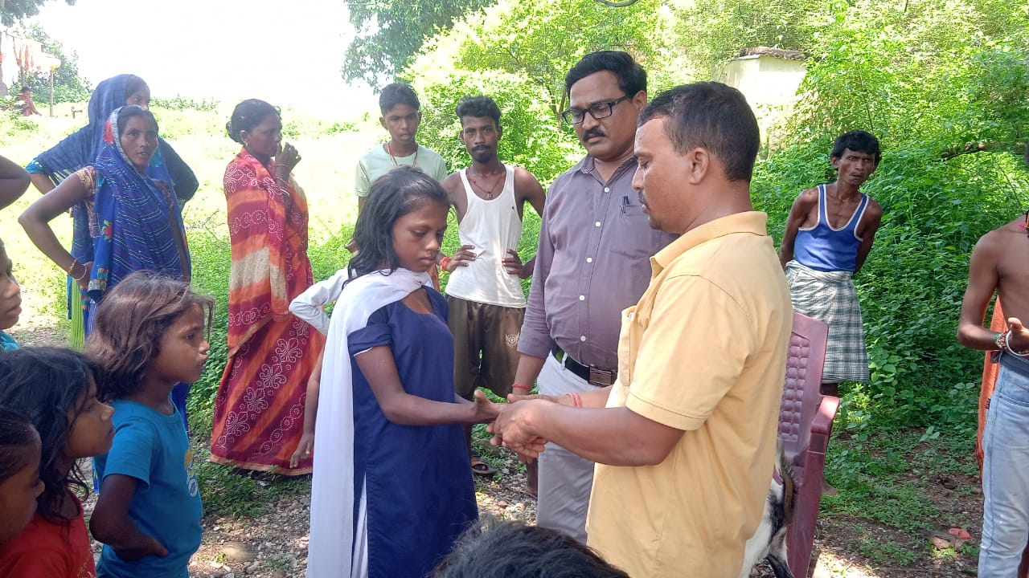
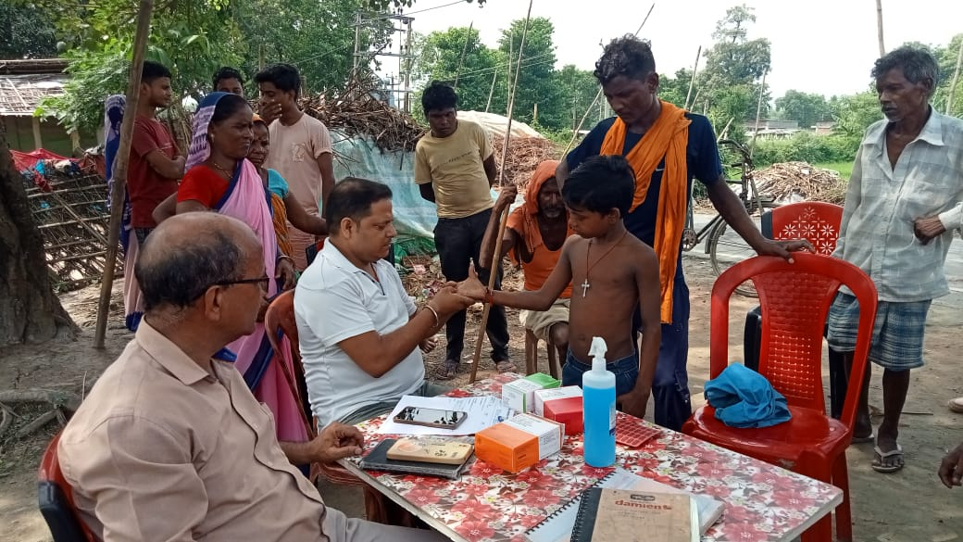
On the job training
Accompanied field visit with Secondary level Nodal Persons

Slide 23
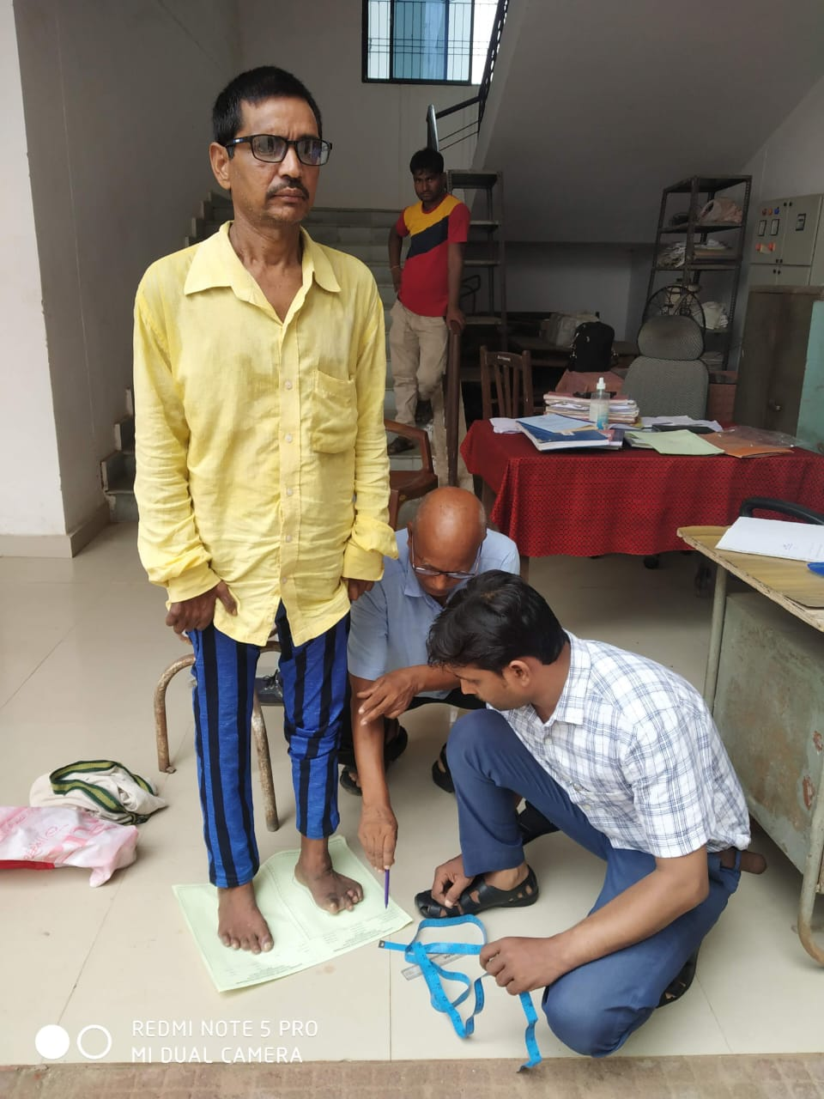
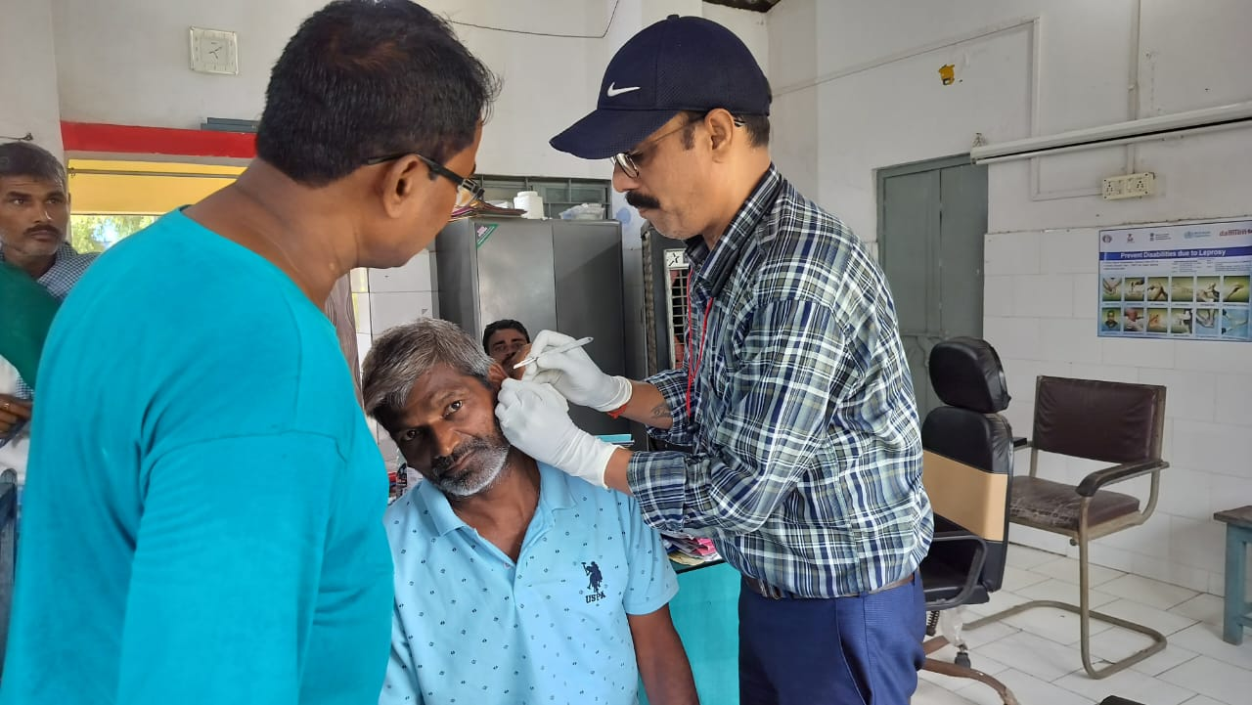
Customised footwear measurement by Nodal person (district)
Skin smear by Nodal person (district)

Slide 24
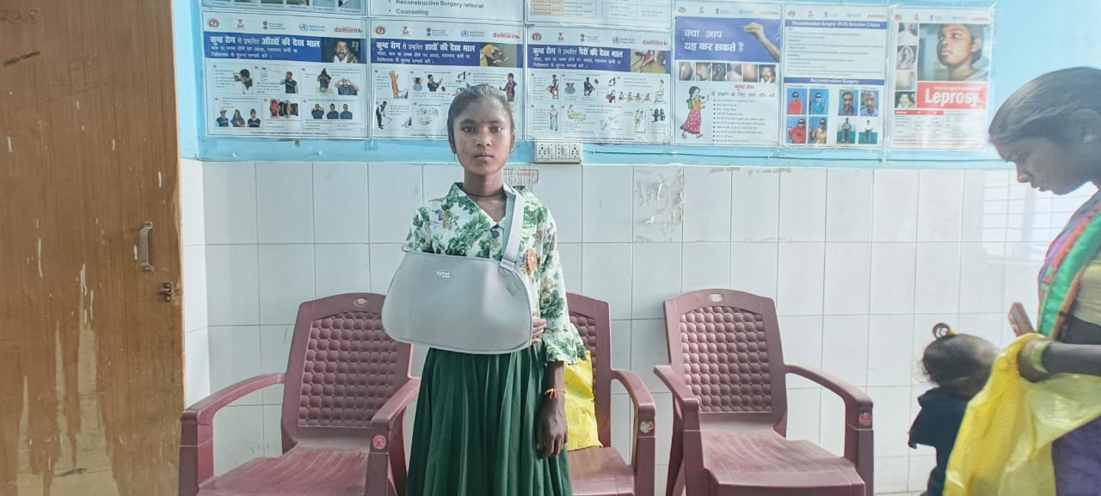
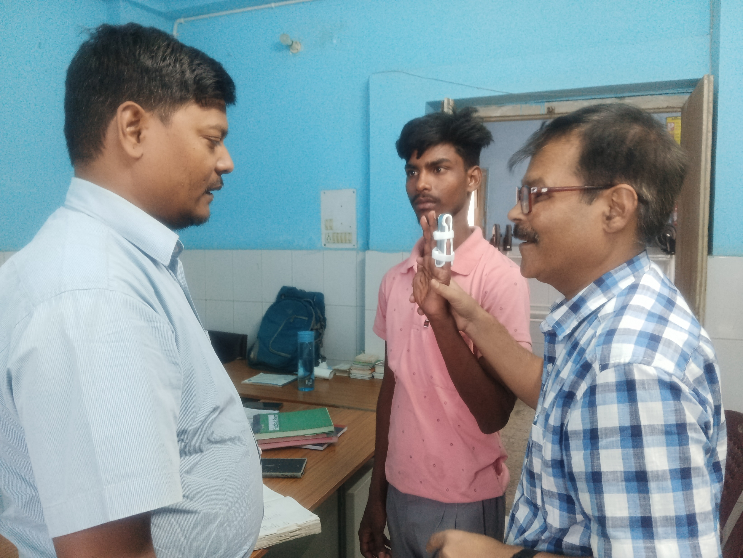
Assistive device provided:

Slide 25
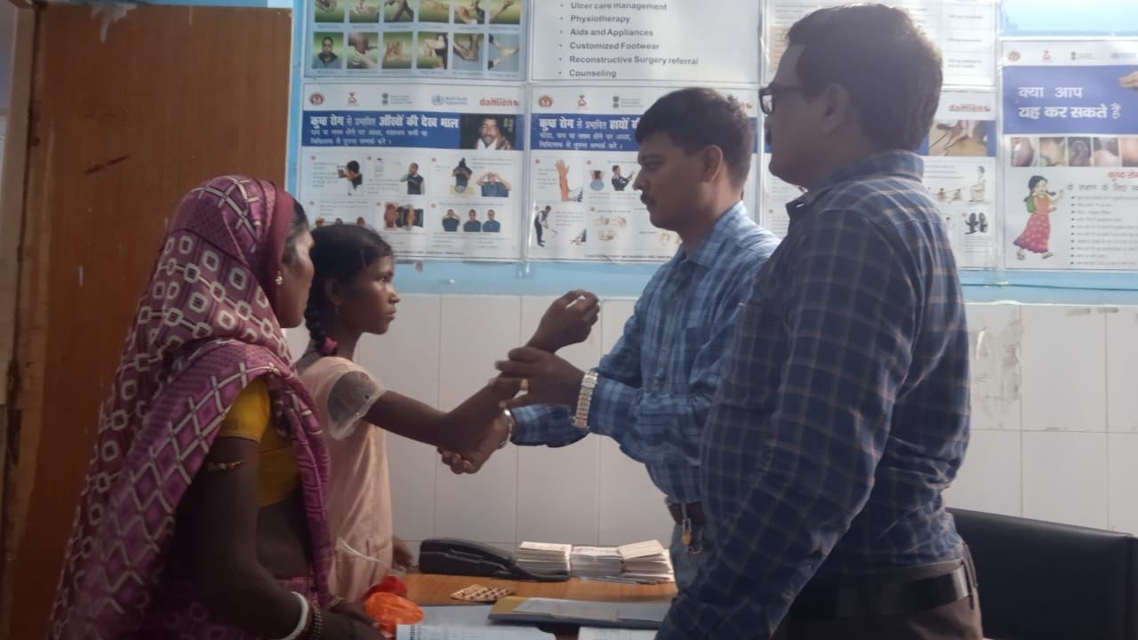
Child Case Assessment:

Slide 26
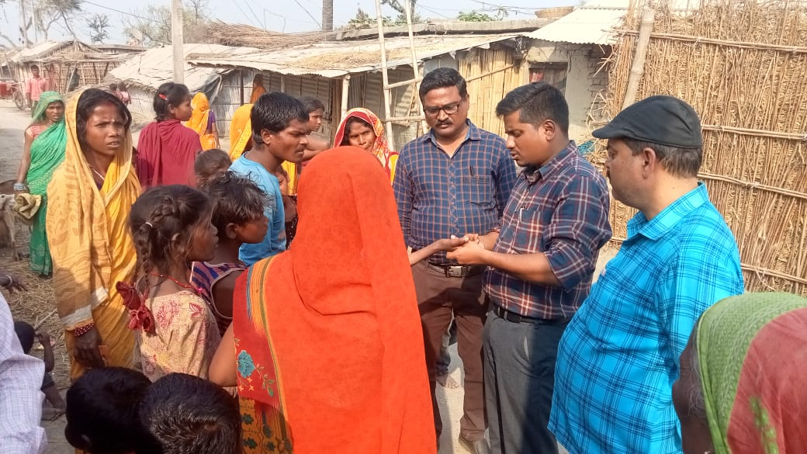
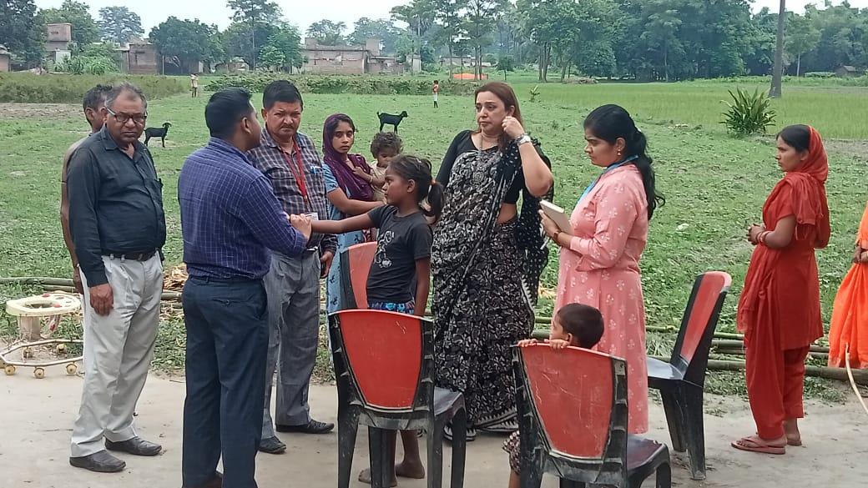
Patient Visit – On-the-job

Slide 27
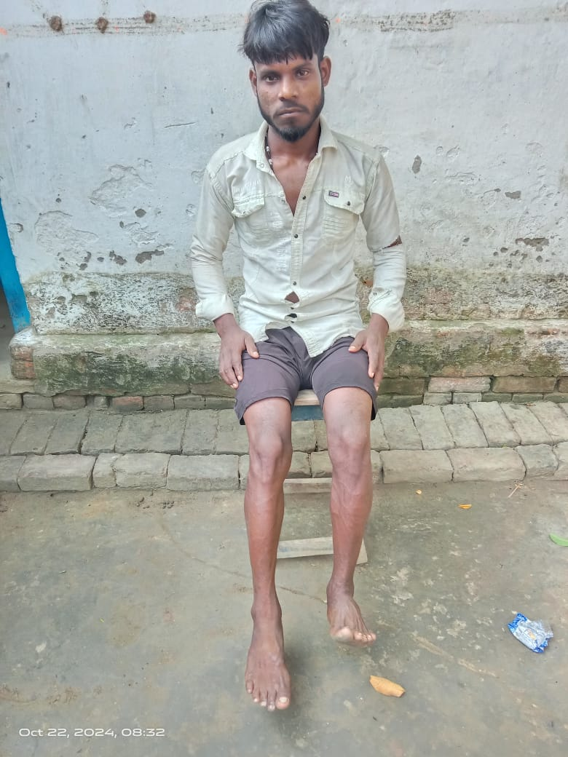
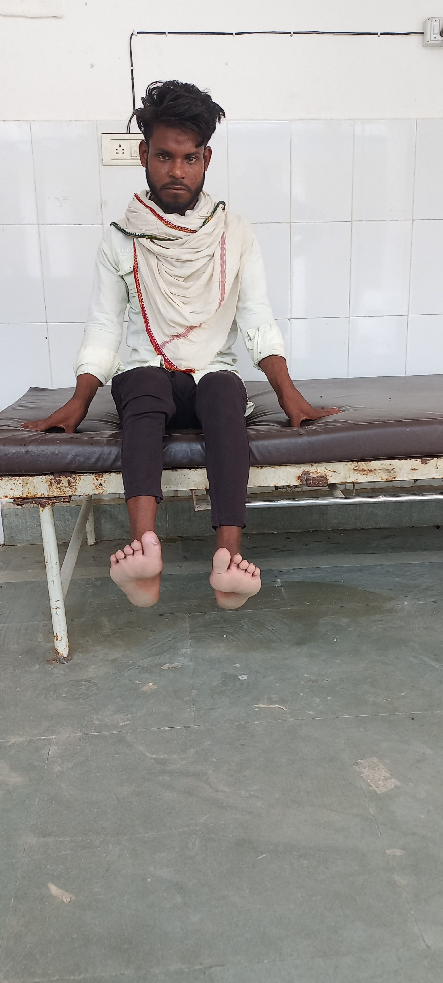
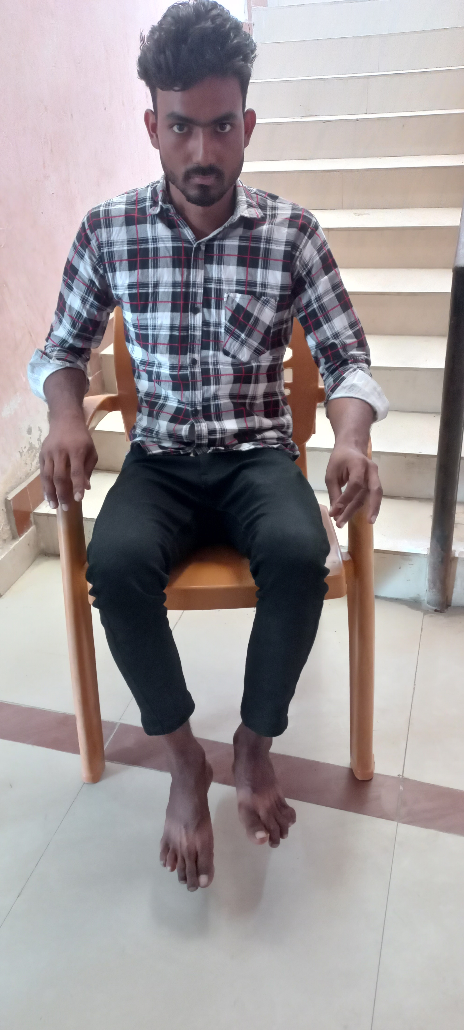
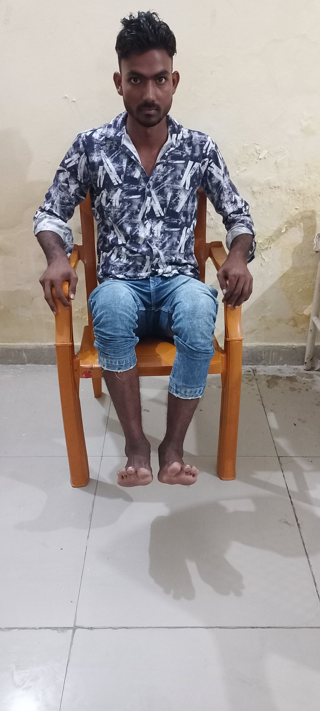
Patient Management at SLRC Level:

Slide 28
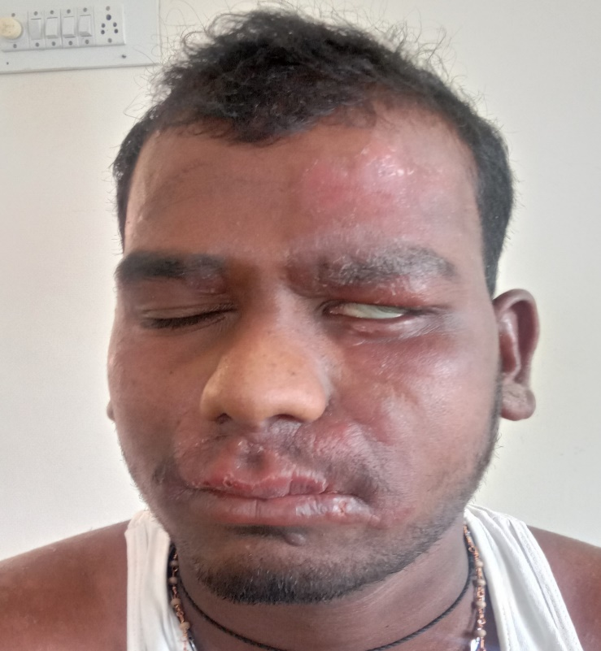
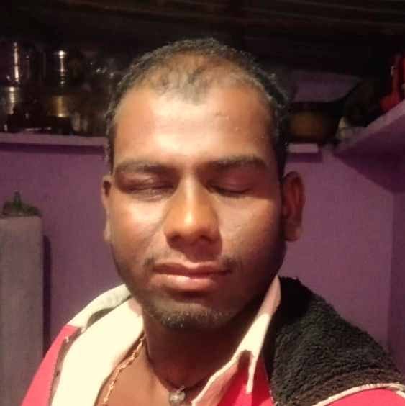
Patient was managed by nodal person (district)

Slide 29
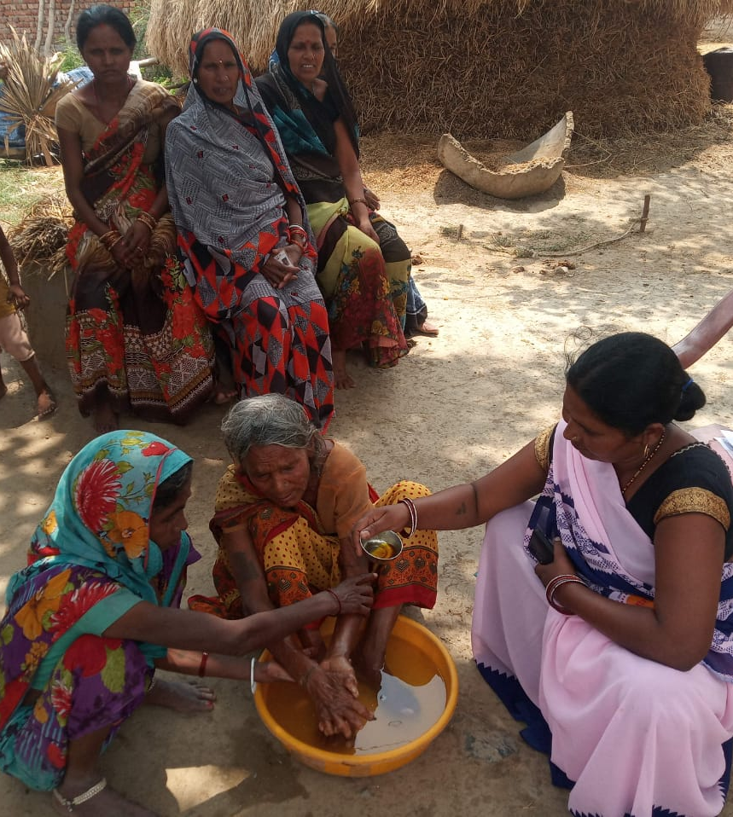
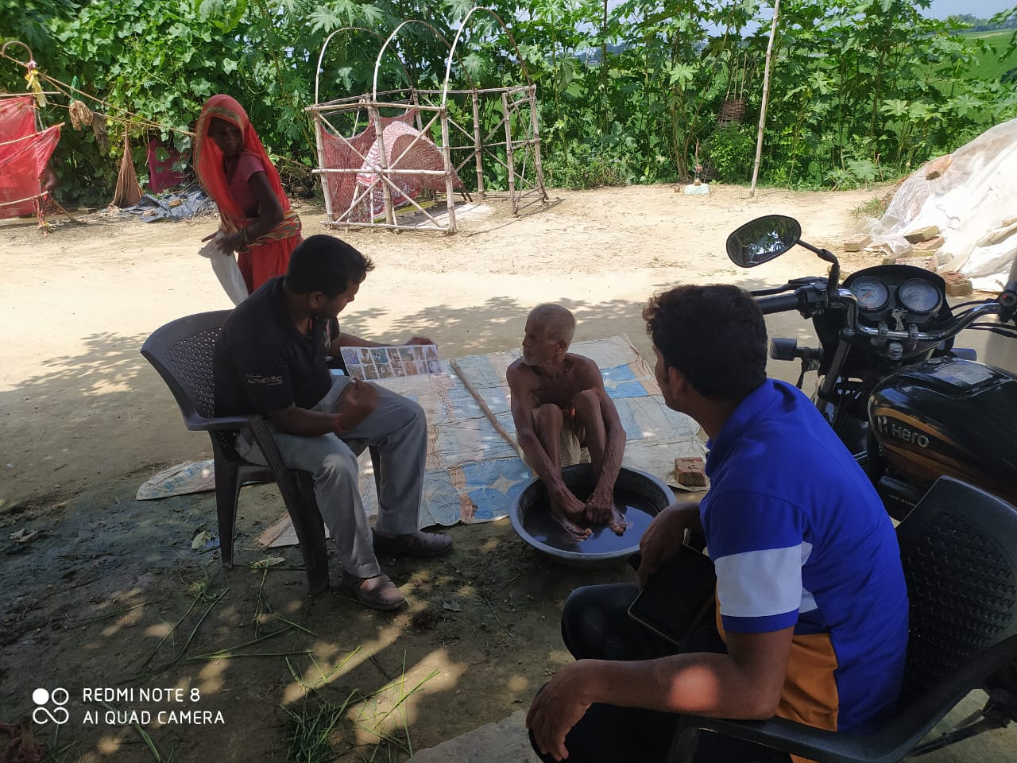
Self care monitoring by ASHA and CSW

Slide 30
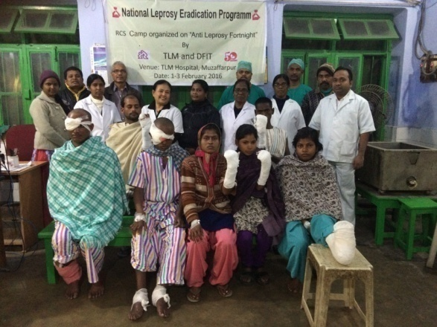
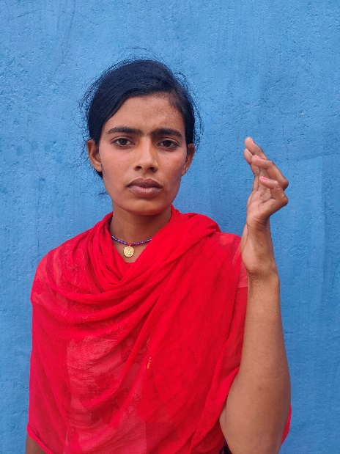
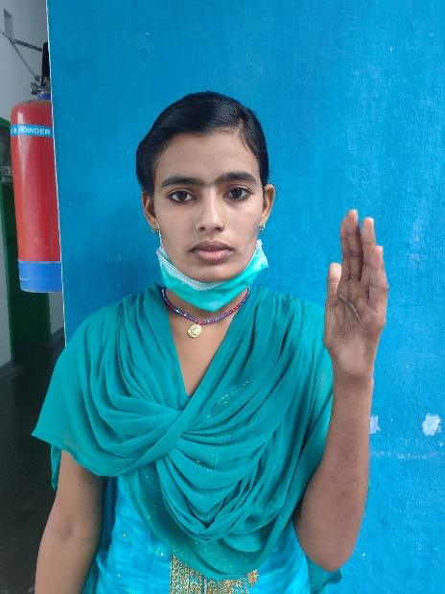
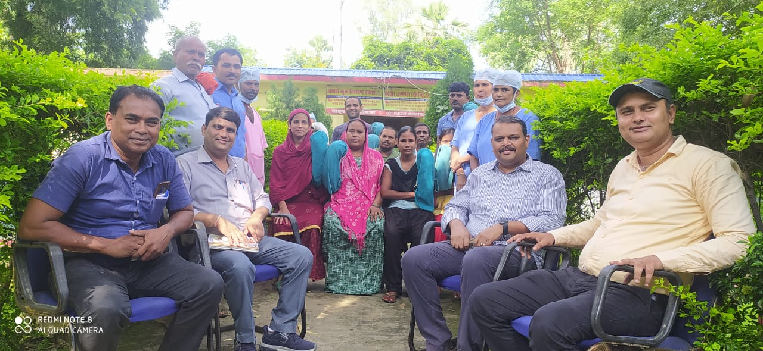
Before and after RCS
Re constructive surgery Camp at Dehri On Sone

Slide 31
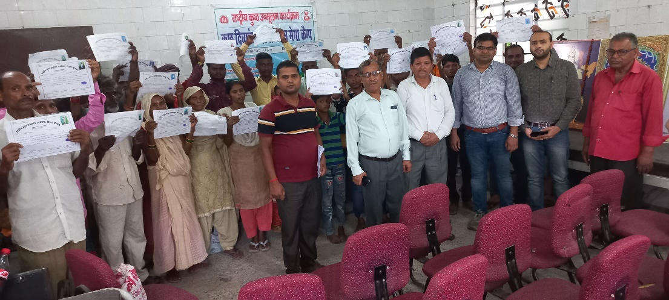
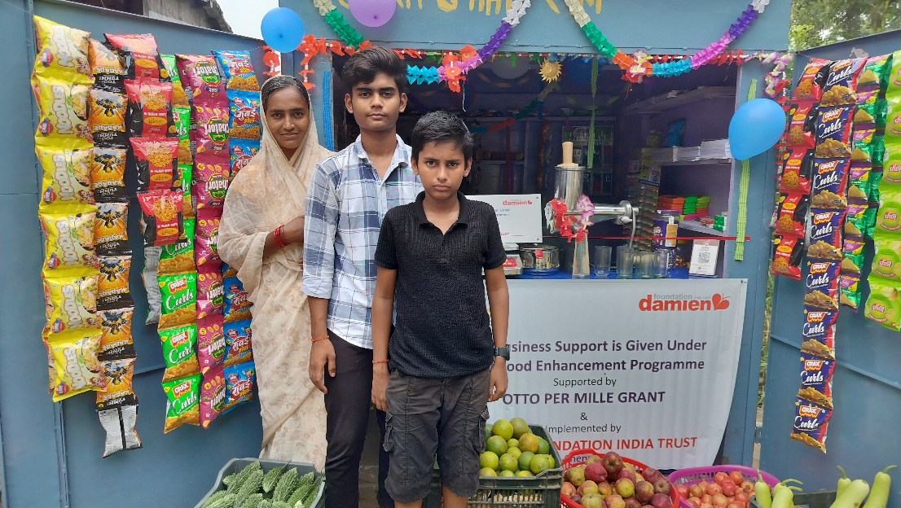
Livelihood Enhancement Support
Disability certificate facilitation

Slide 32
Thank you

